Slide 1


From Open Access to
Open Science from the Viewpoint of a Scholarly Publisher
Lyubomir Penev
Bulgarian Academy of Sciences & Pensoft Publishers, Sofia
iDiv, Leipzig, 15 Feb 2017

Slide 2

Some facts about Pensoft
Founded in 1992
Headquarters in Sofia
Now 25 permanent employees
Notes:
My suggested heading would be “Background to Pensoft”

Slide 3
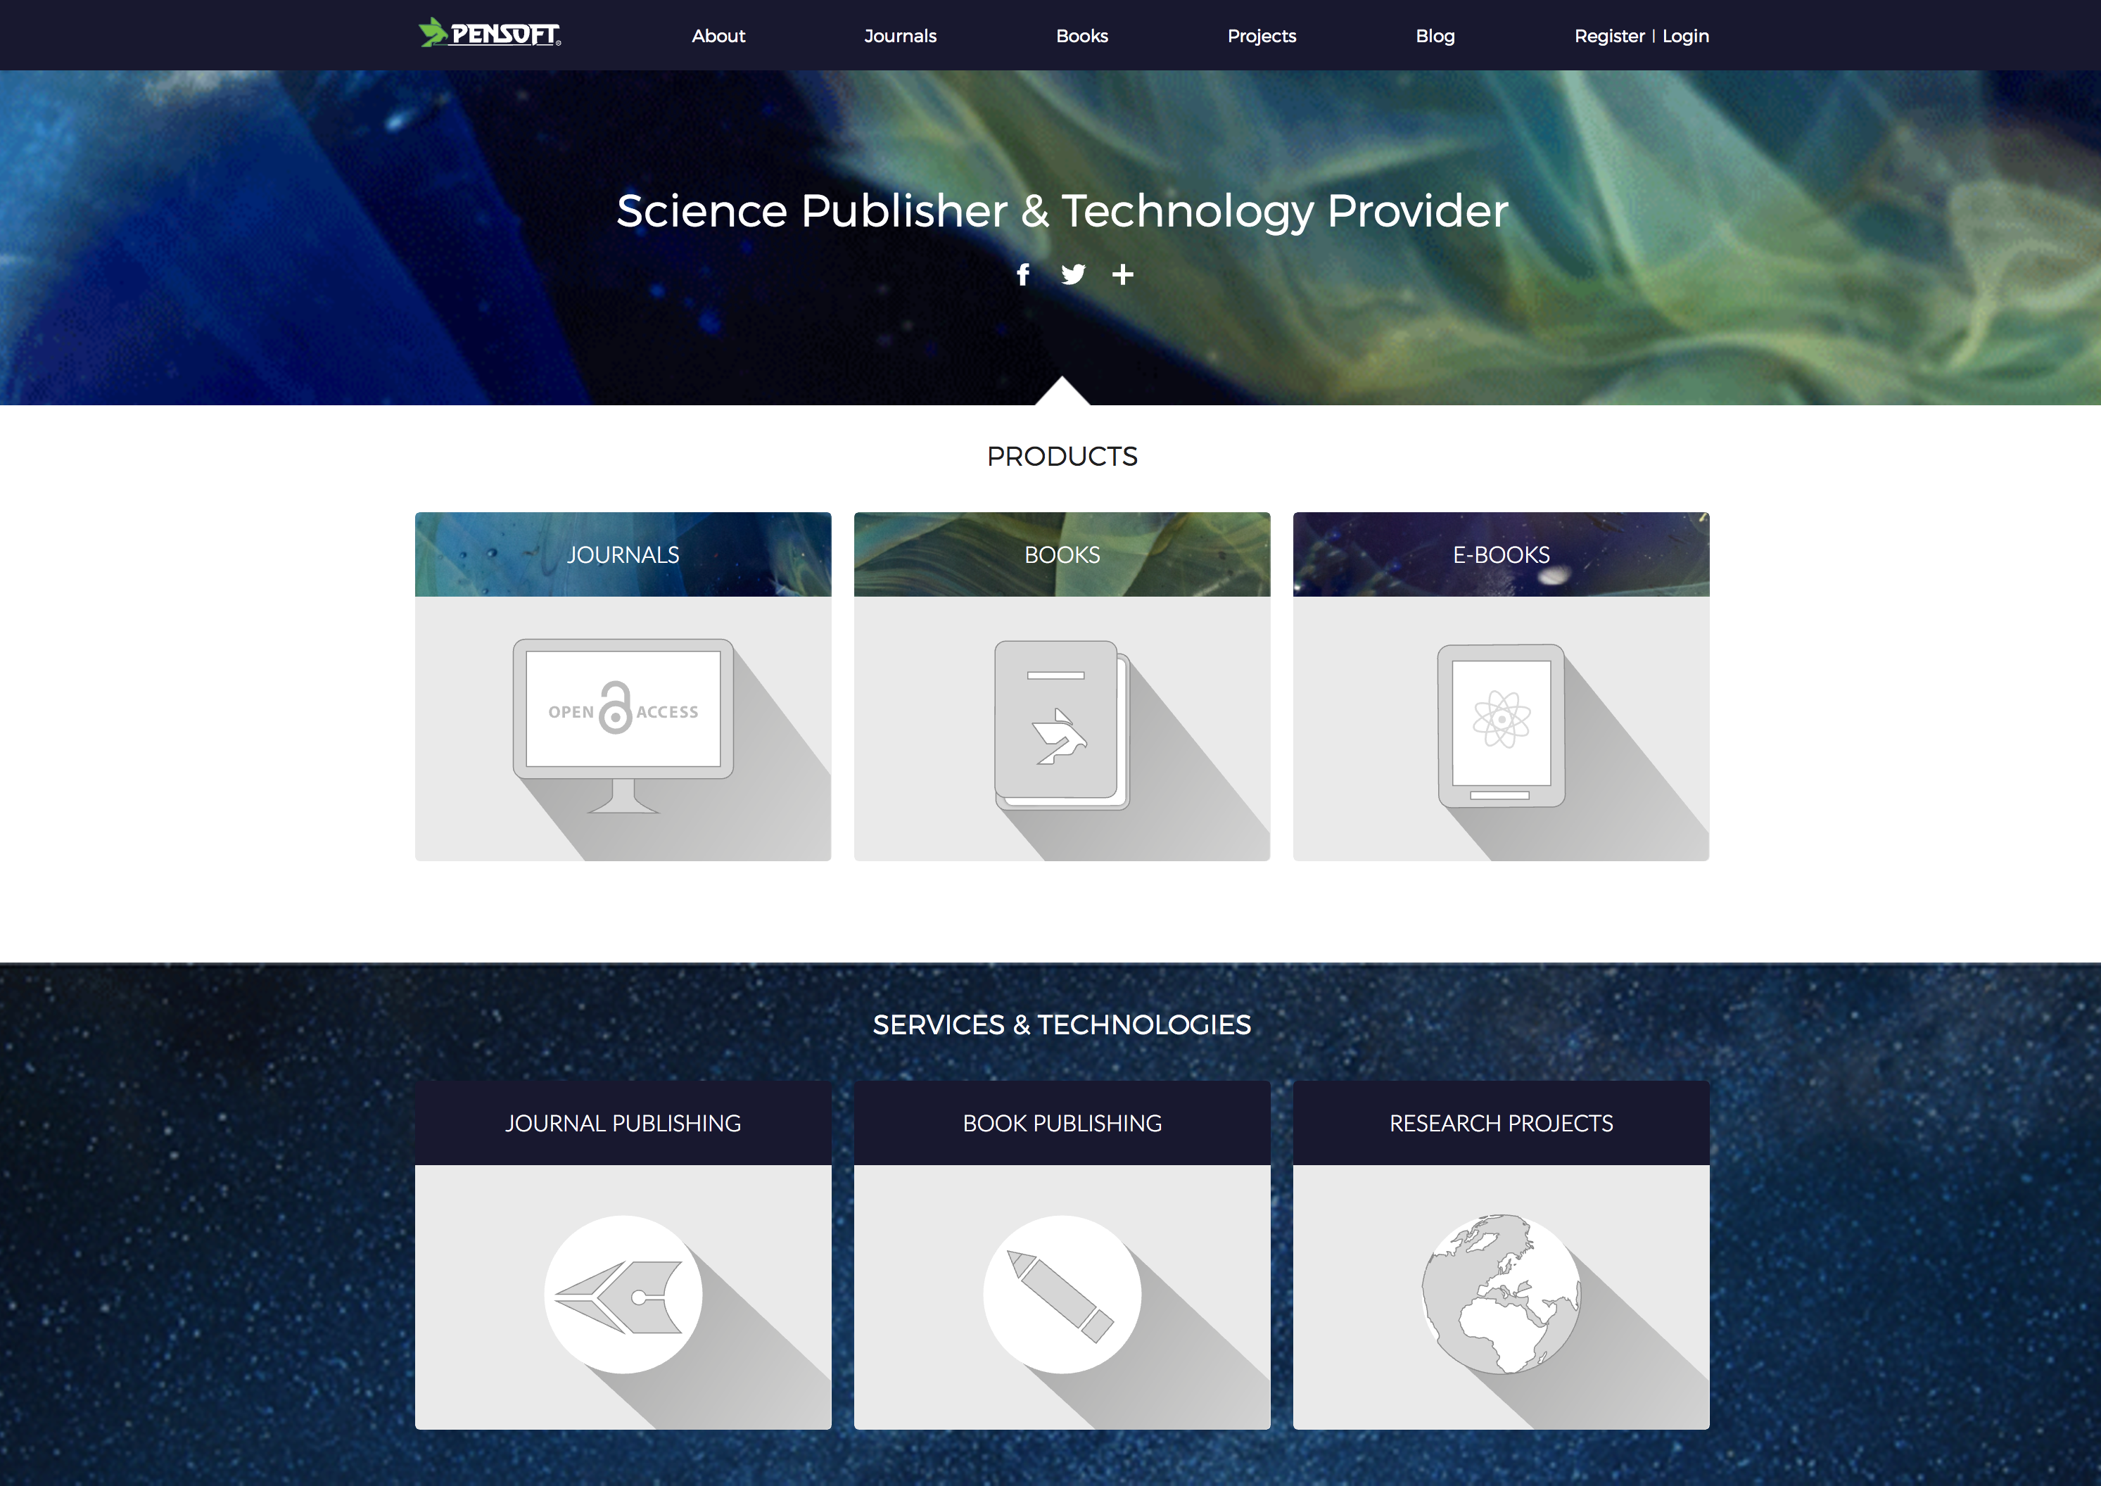
Notes:
The items are rather indistinct and the accompanying text is too small. Would it be possible to highlight the items with more colour so that they stand out more?

Slide 4




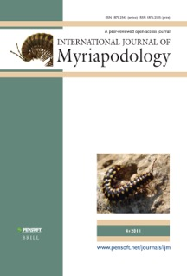

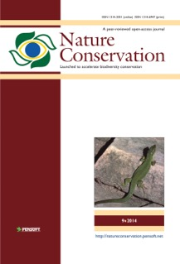
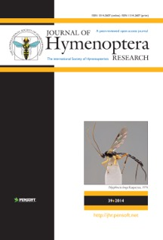
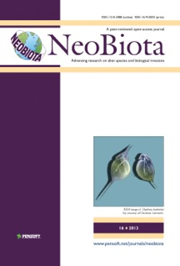

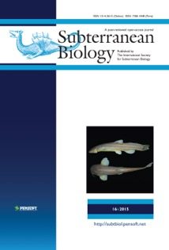

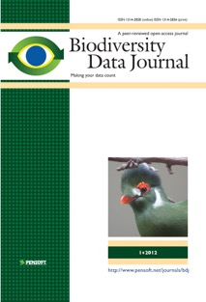
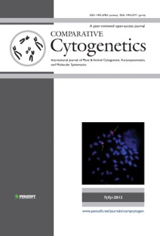
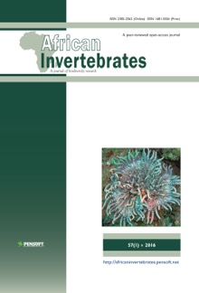



Pensoft’s Open Access Journals

Slide 5
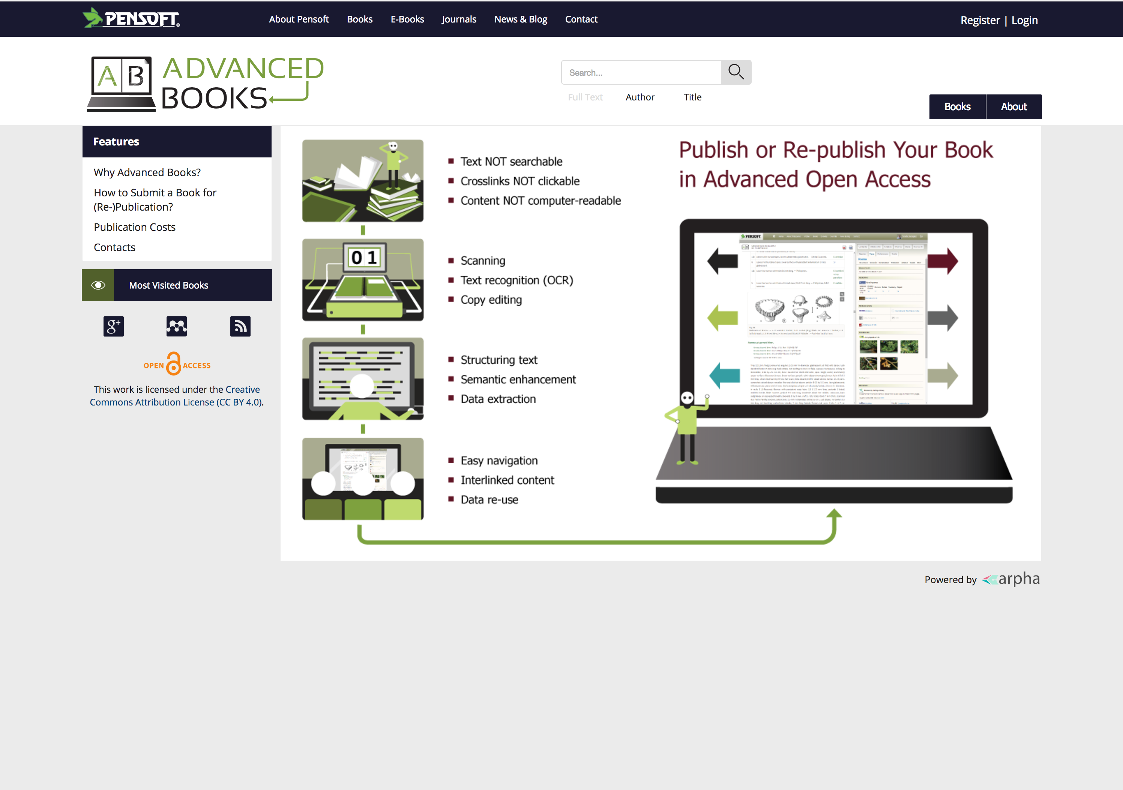
Pensoft’s Open Books Program
More than 1000 book titles since 1994
Advanced Open Access Books

Slide 6
WHY?
CLAIM of this Presentation:
Academic publishers create some bottlenecks that hamper progress in science!

Slide 7

Do publishers really follow the extraordinarily rapid progress in science?

Slide 8
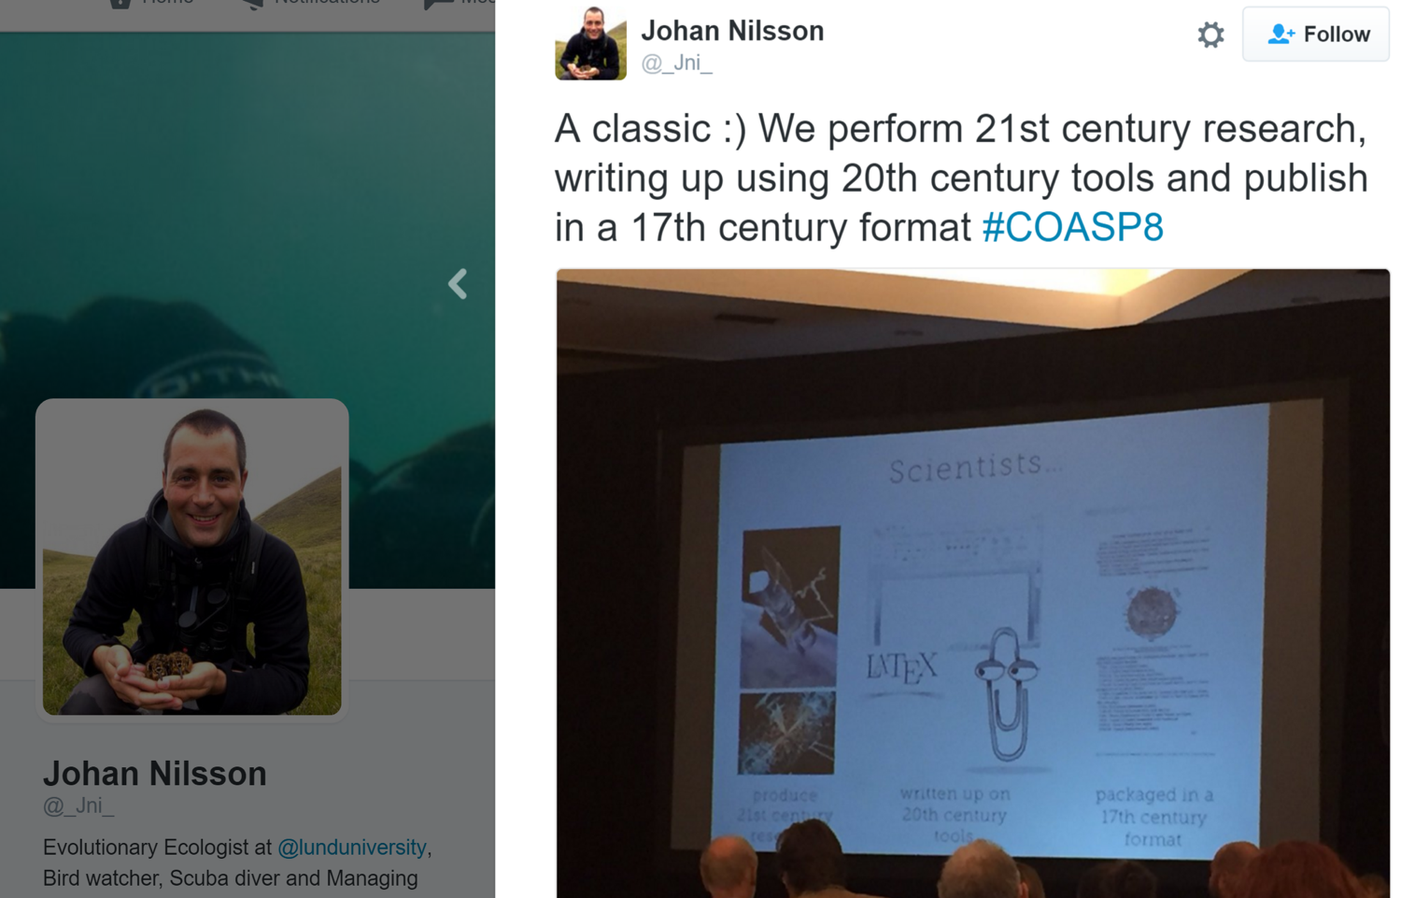
Probably the best answer…

Slide 9

Academic Publishing in Transition
Open access Open science
Human-readable Machine-readable
Data publishing Data re-use
Impact Factor Article-Level Metrics
Publishing Technology-Driven Service
Technology Critical for journals’ survival
Notes:
The arrows need to be re-positioned so as not to overlap the text (I’ve done one as an example).
If possible, the text should be positioned in one line for each arrow.

Slide 10
Modernise or perish!
Publisher’s Dilemma

Slide 11
In the beginning was the Open Access…
Open Access
Open Data
Open Science

Slide 12
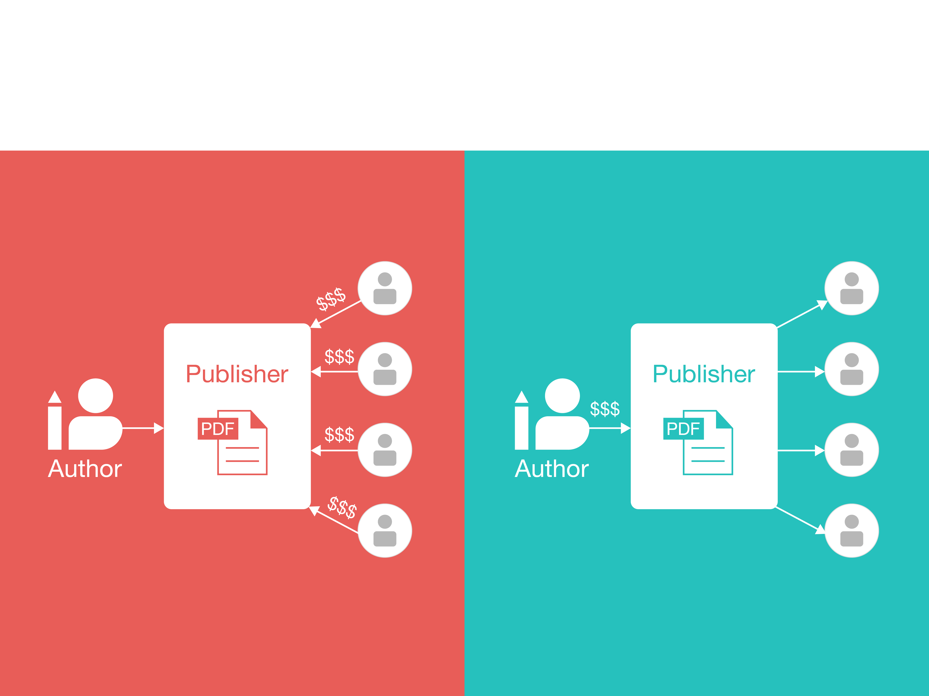
The Simplistic View on Open Access
Traditional publishing
Open access publishing
Notes:
Do these slides indicate that the author does NOT get paid?
There is an arrow missing on the Open Access slide (second Reader down)

Slide 13

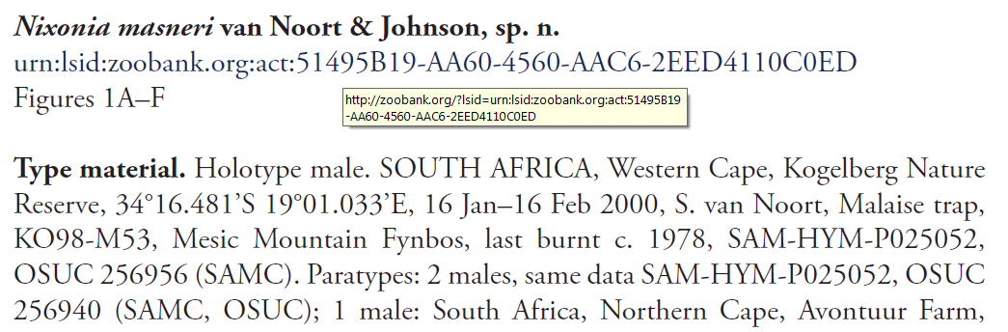
Open Access PDF: Nice, but not enough!

Slide 14


The PDF/paper is an Impediment!
(even if they are Open Access)

Slide 15
The XML as the first step to open content
<taxon-name-part taxon-name-part-type="genus">Nixonia</taxon-name-part>
  <taxon-name-part taxon-name-part-type="species">masneri</taxon-name-part>
  </taxon-name>
  - <taxon-author>
  <string-name>van Noort & Johnson</string-name>
  </taxon-author>
  <taxon-status>sp. n.</taxon-status>
  <xref>Figures 1A-F</xref> a

Slide 16

Why do XML markup?
Frequently Asked Question

Slide 17
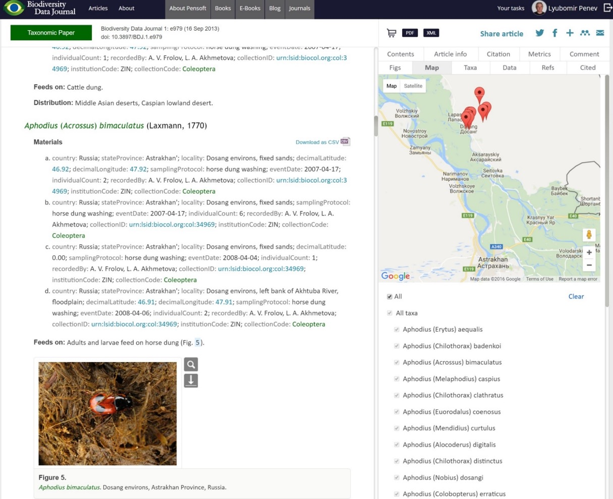
Automated mapping

Slide 18
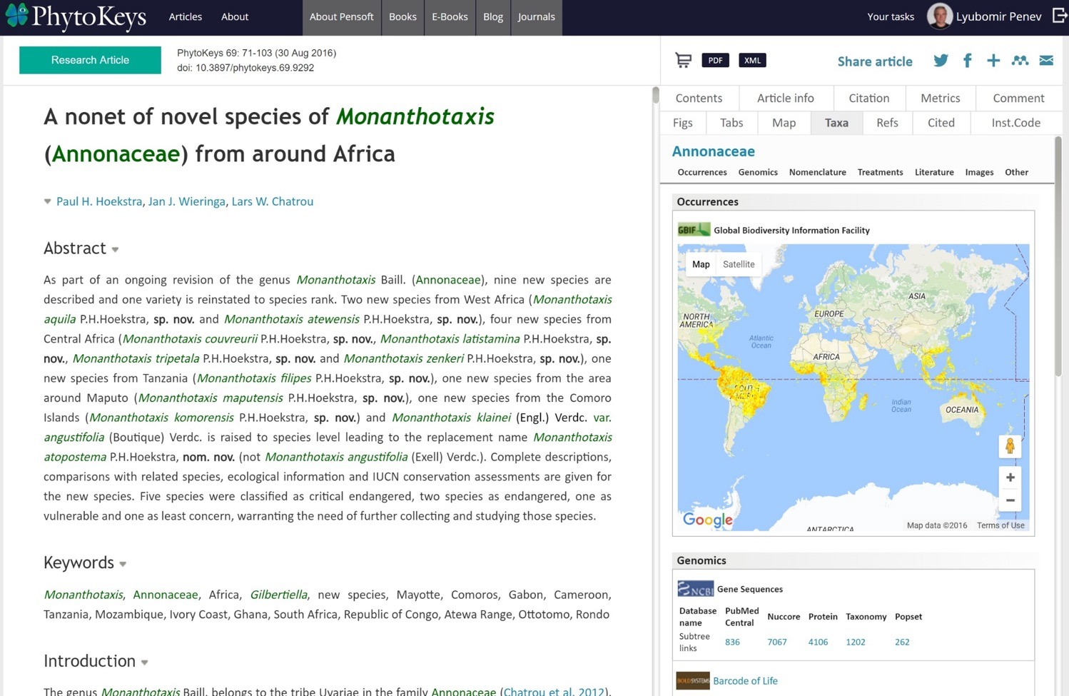
Taxon profile in real time
Species Profiles on the Fly (1)

Slide 19
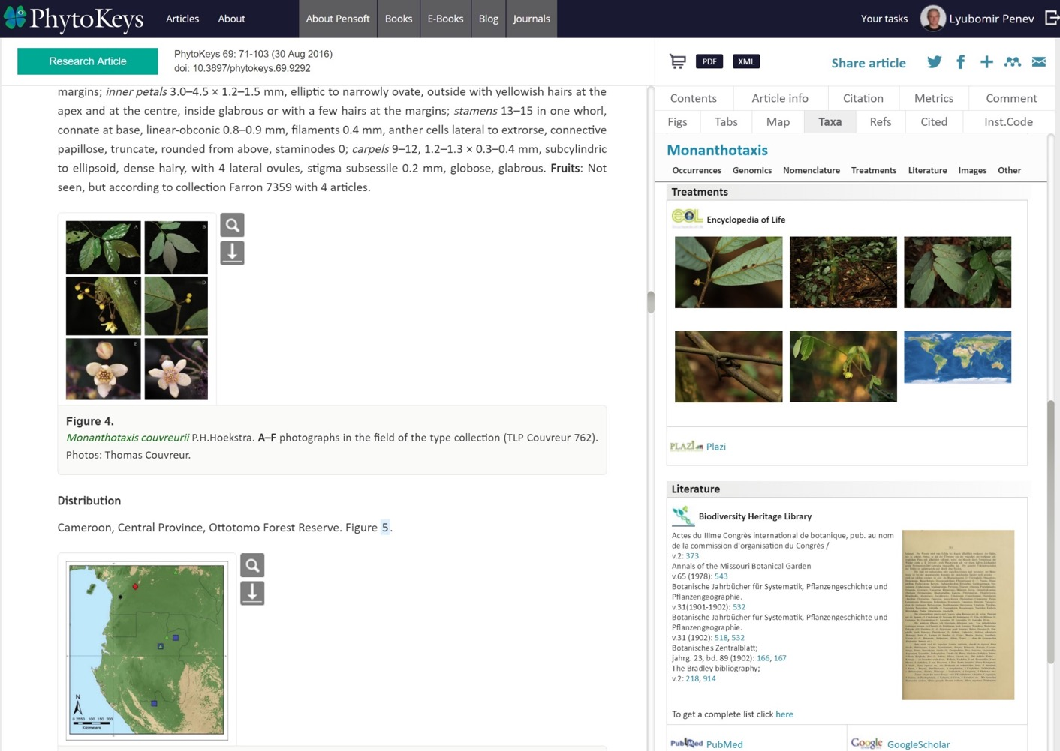
Species Profiles on the Fly (2)

Slide 20



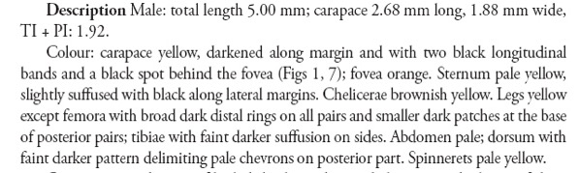


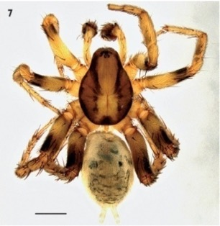

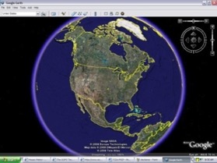
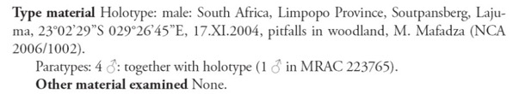
This is how it started
Text is not just structured, it is machine-readable!
Nomenclature
Literature
Descriptions
Images
Occurrences

Slide 21
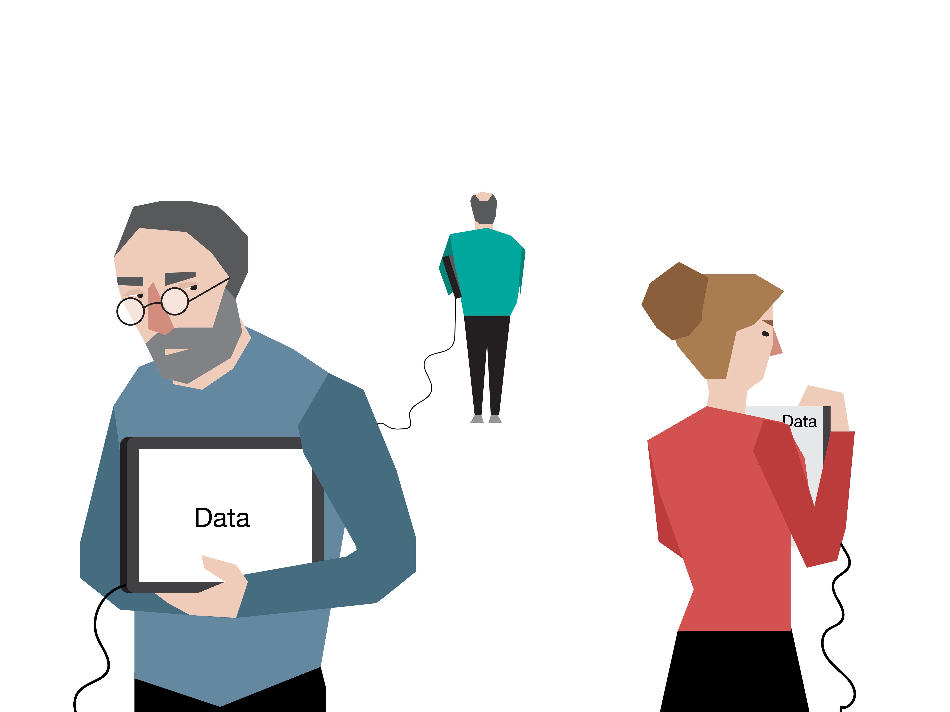
All fine, but where are the data?

Slide 22

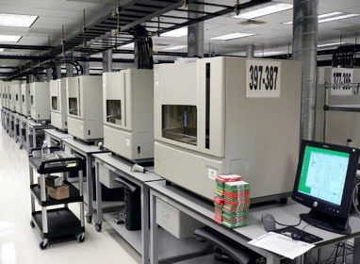

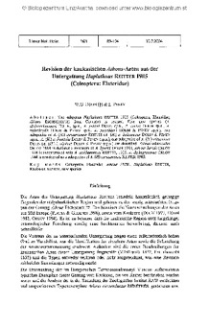

The (mis)fortune of research data
Primary
data
Drawings: Slavena Peneva DNA sequencer image: Wikimedia

Slide 23
The Second Day: Let data be open …
Open Access
Open Data
Open Science

Slide 24
How open data should look...
1. Start with
a plan
2. Select
your data
5. Maintain
Open Data
Process
4. Publish
3. Create
your data
Credit: Scottish Government, http://www.gov.scot/Publications/2016/08/5556/6

Slide 25
Four Models of Open Data Publishing
Supplementary data files published with the article
Data deposited in repositories and linked to the article they underpin
Data papers, describing data
Integrated data and narrative publishing

Slide 26

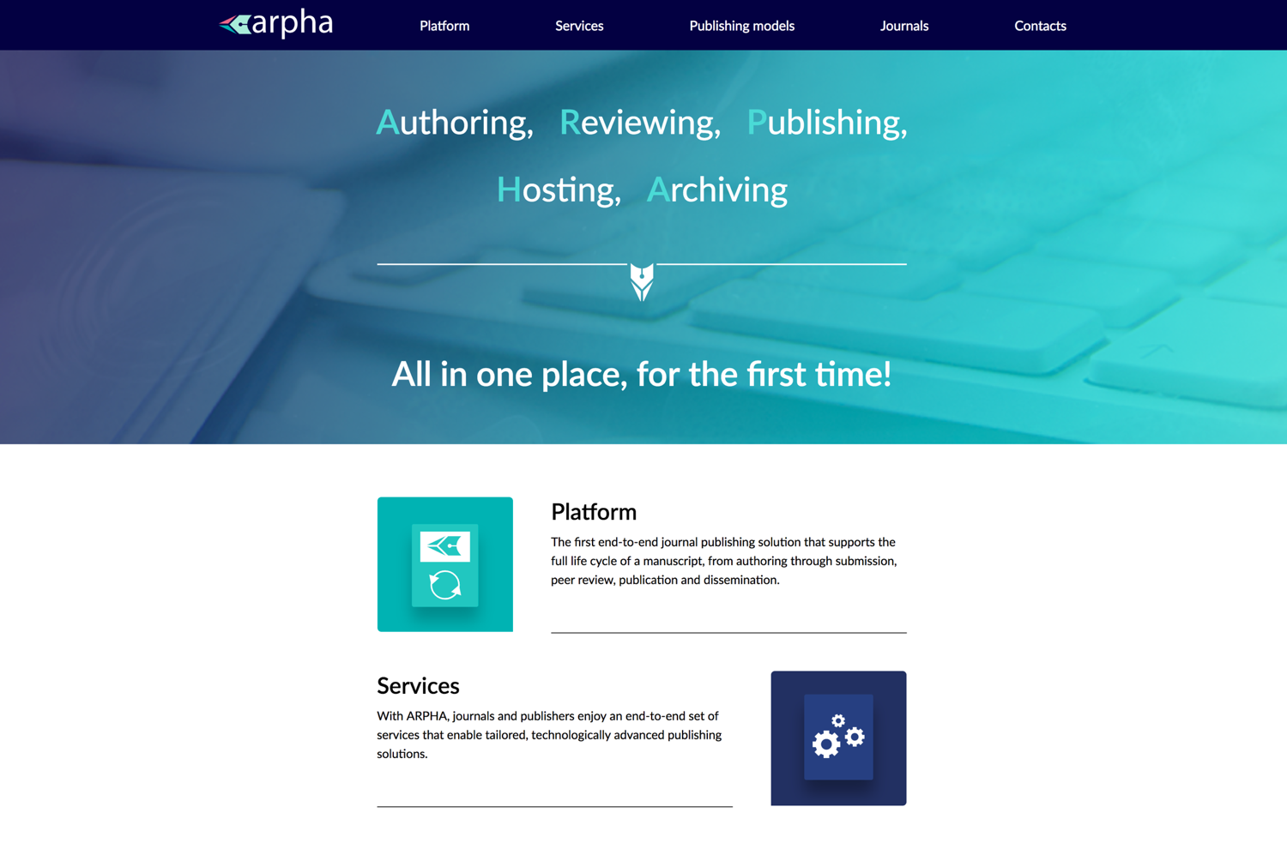
Now comes ARPHA

Slide 27

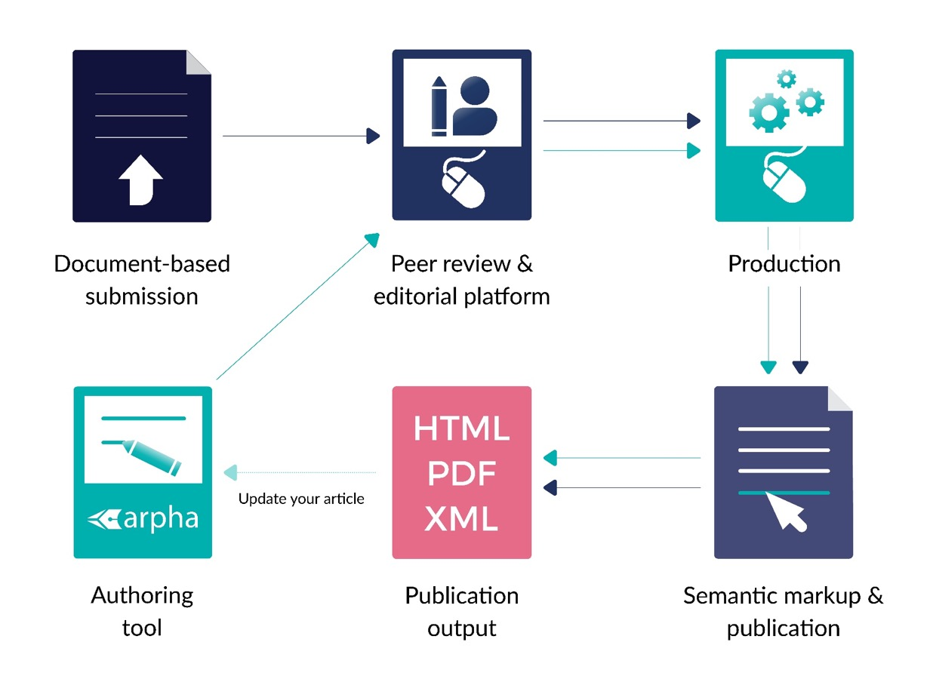
Two Journal Publishing Workflows:
ARPHA-XML & ARPHA-DOC

Slide 28
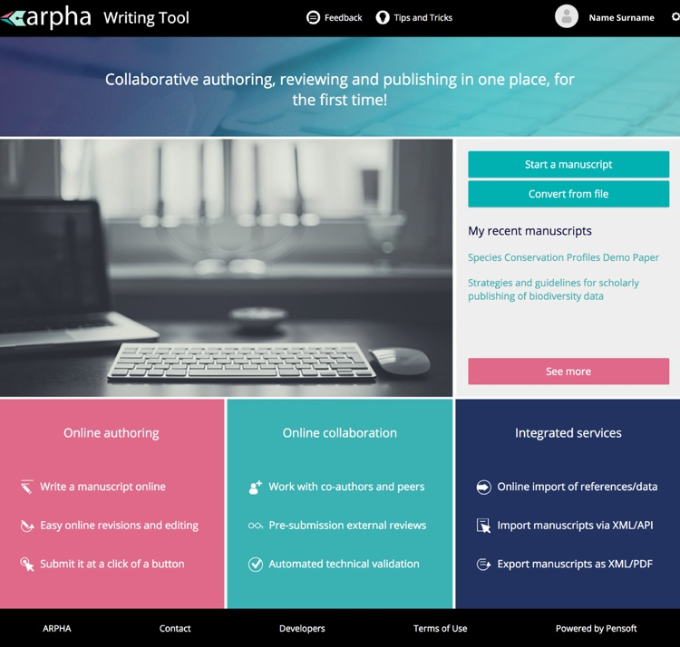
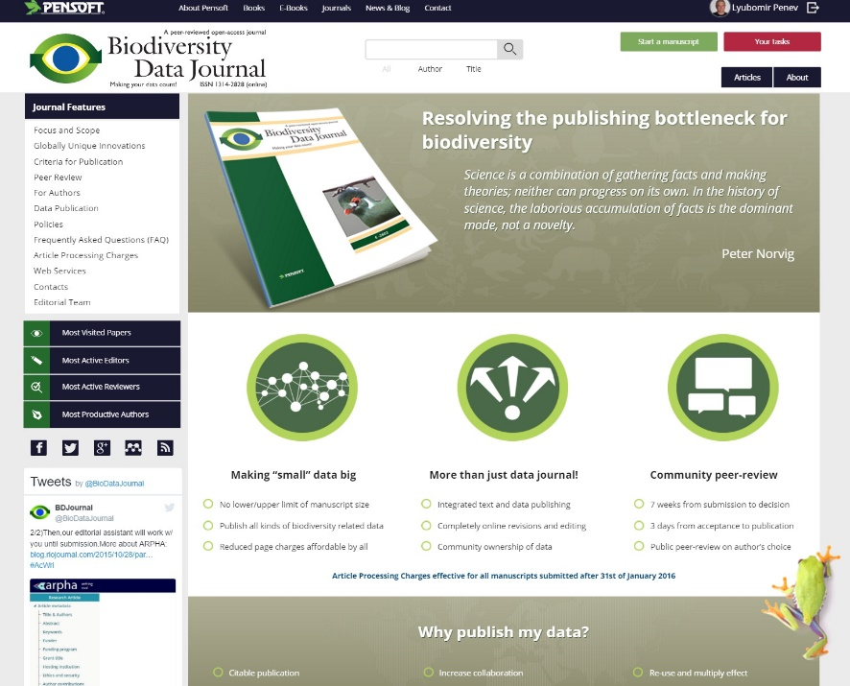
ARPHA-XML Workflow
Next-Gen taxonomy requires Next-Gen publishing
+
Authoring
Data import
Peer review
Publication
Dissemination
All within a single online collaborative platform
Notes:
For presentation, the bullet point Dissemination should be within the box.

Slide 29


The first
Open Science Journal publishing the
entire research cycle!
Notes:
The text Research Ideas and Outcomes should be re-formatted to be within the text box.

Slide 30
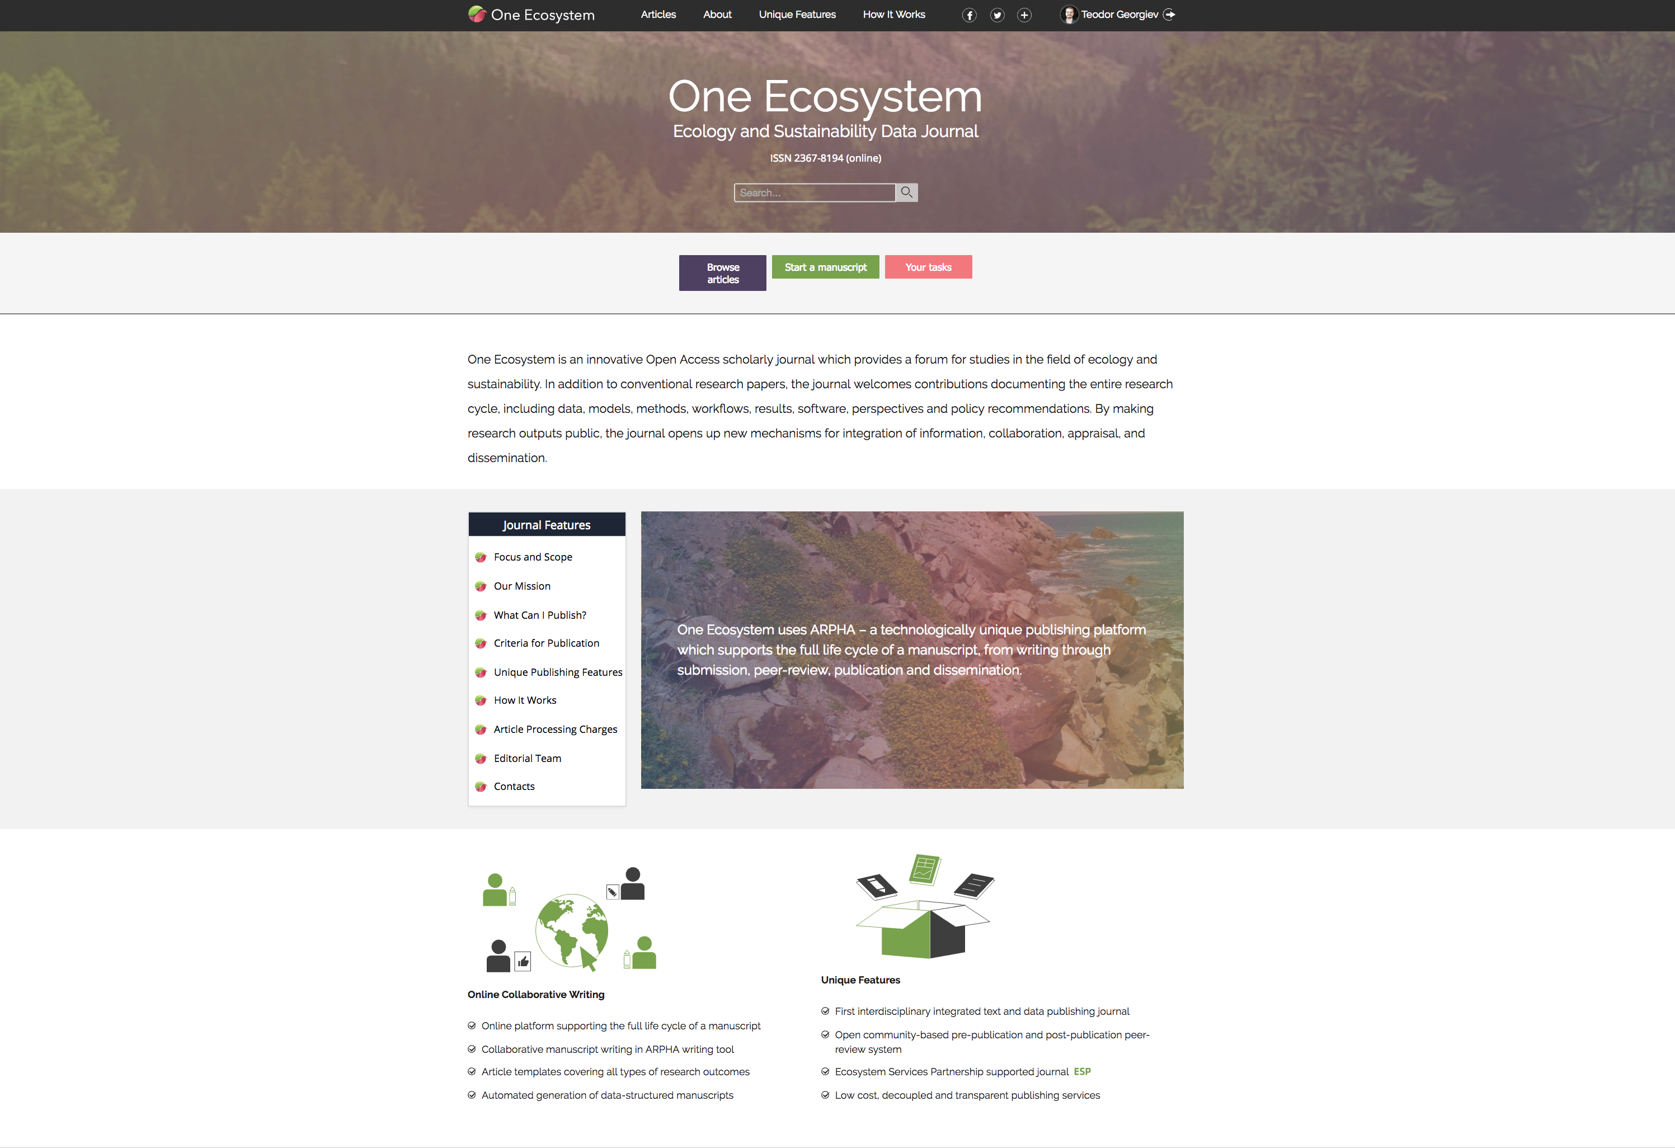
Notes:
My comment as a viewer - this slide is very “flat” and does not attract attention.

Slide 31
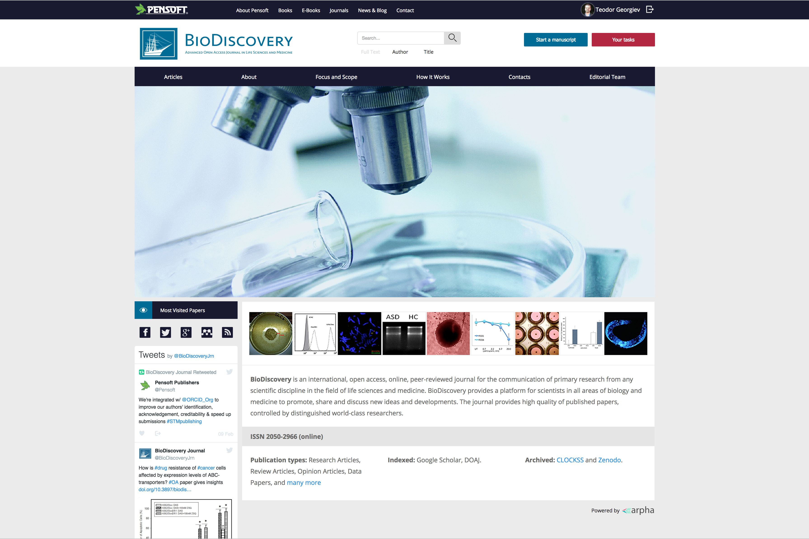

Slide 32
Forthcoming in March 2017
Metabarcoding and Metagenomics
journal

Slide 33
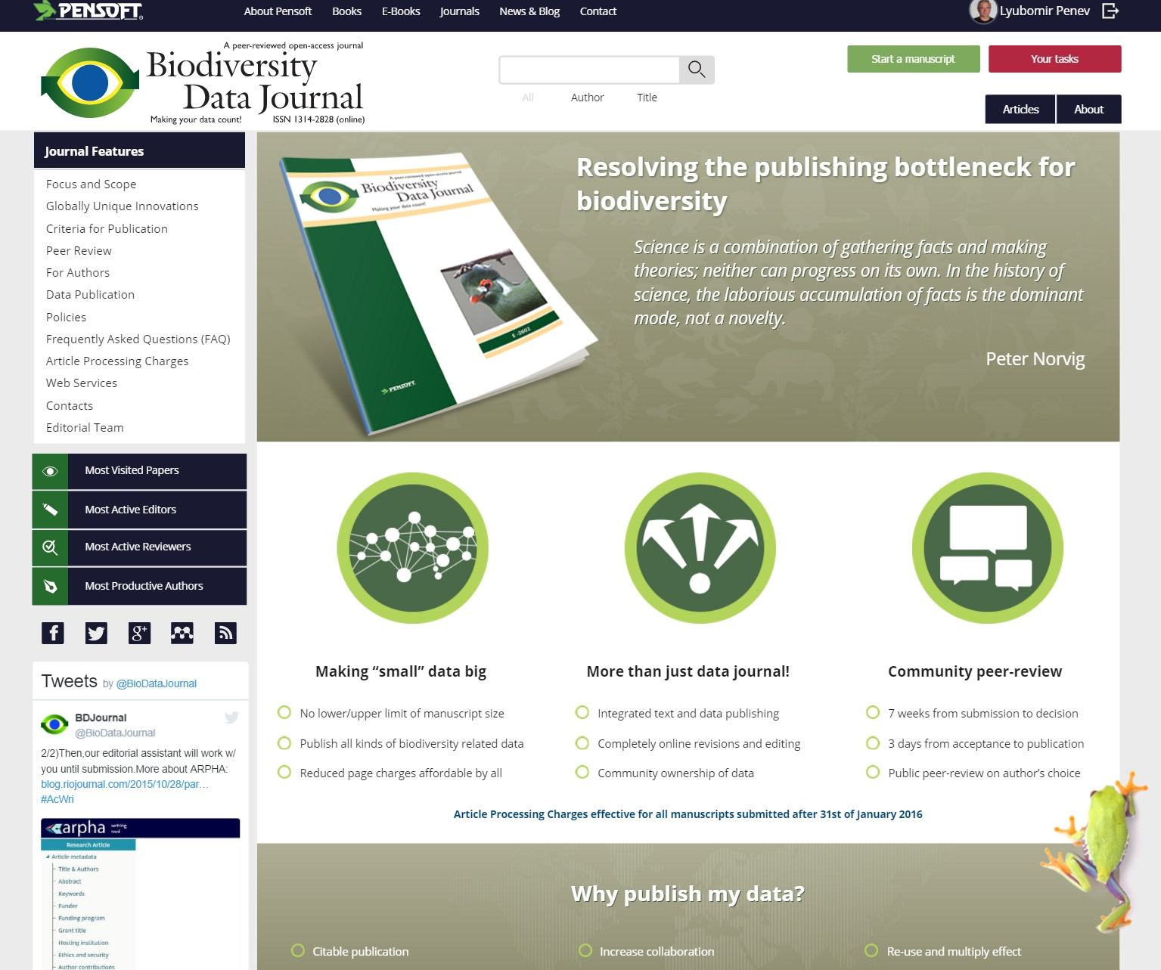
Step 1: Start a manuscript
Notes:
Could a word be added after Step 1 to say what it is?

Slide 34
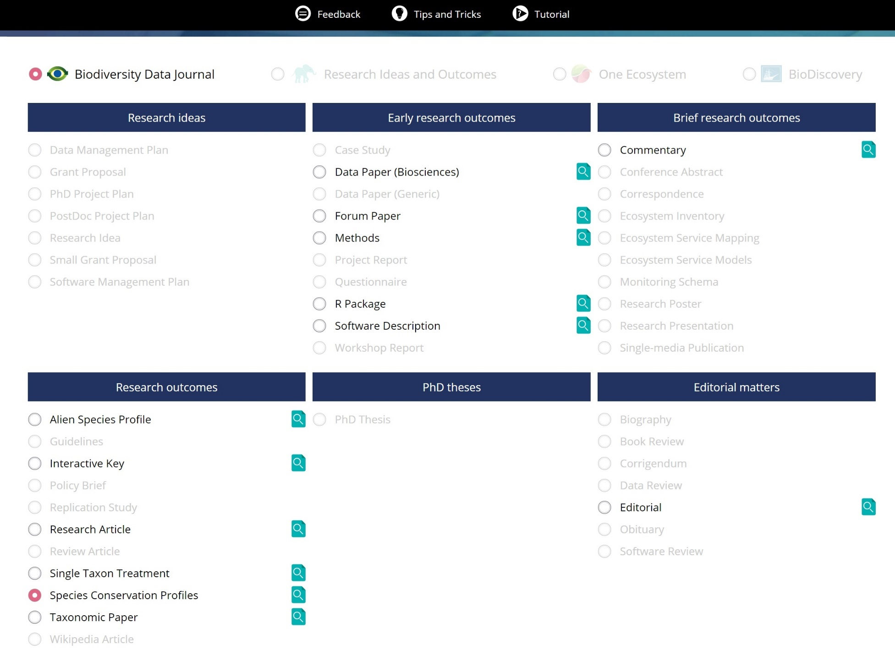
Step 2: Select article template
Notes:
Step 2 - add word to describe what it is.

Slide 35
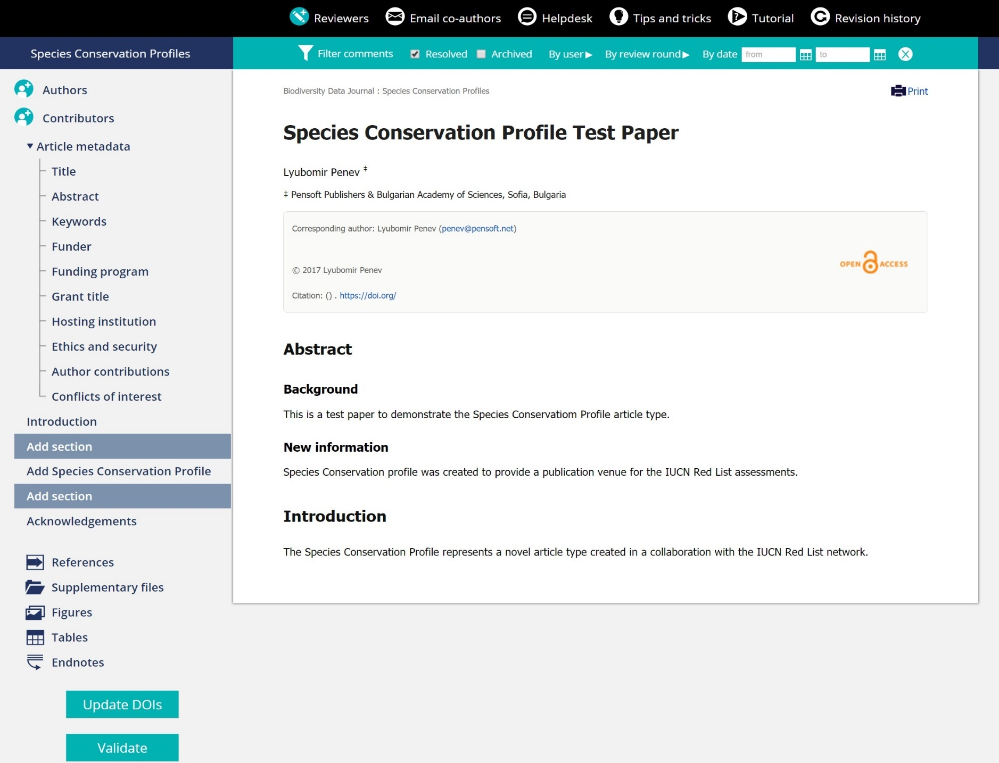
Step 3: Manuscript opened
Notes:
Step 3 - add word to describe what it is.

Slide 36
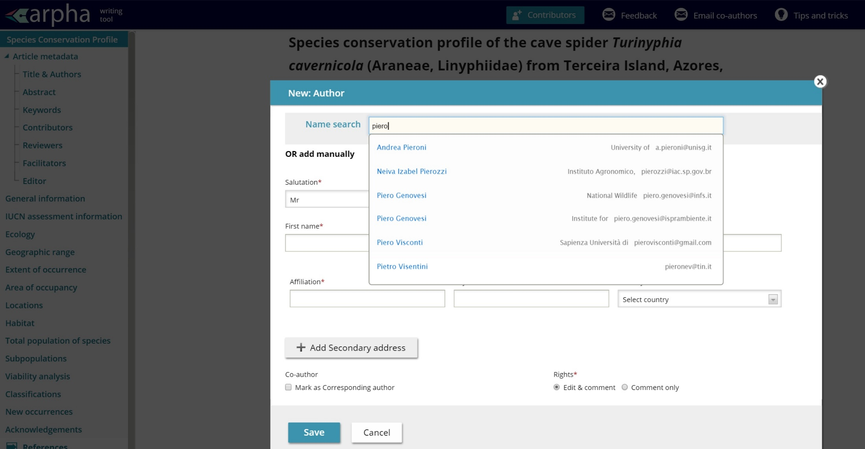
Invite Co-authors

Slide 37
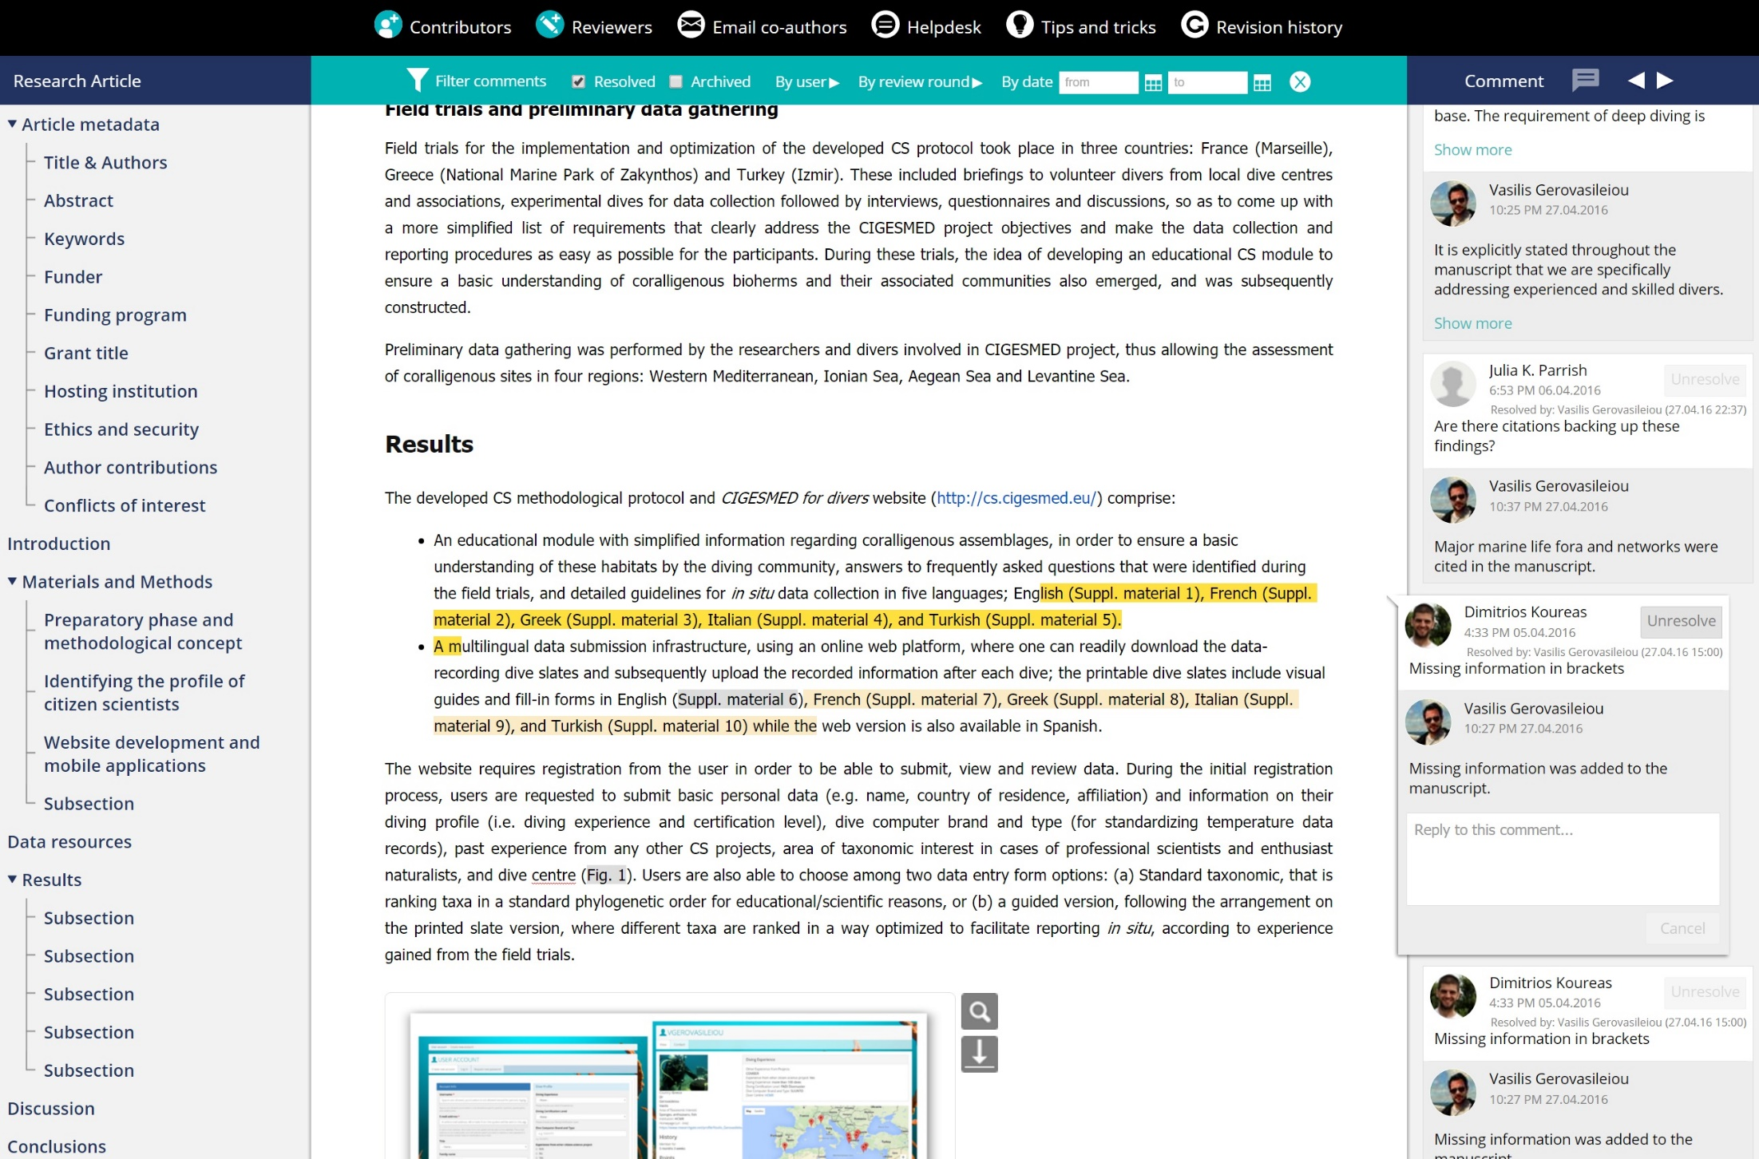
Work with your co-authors & peers online

Slide 38
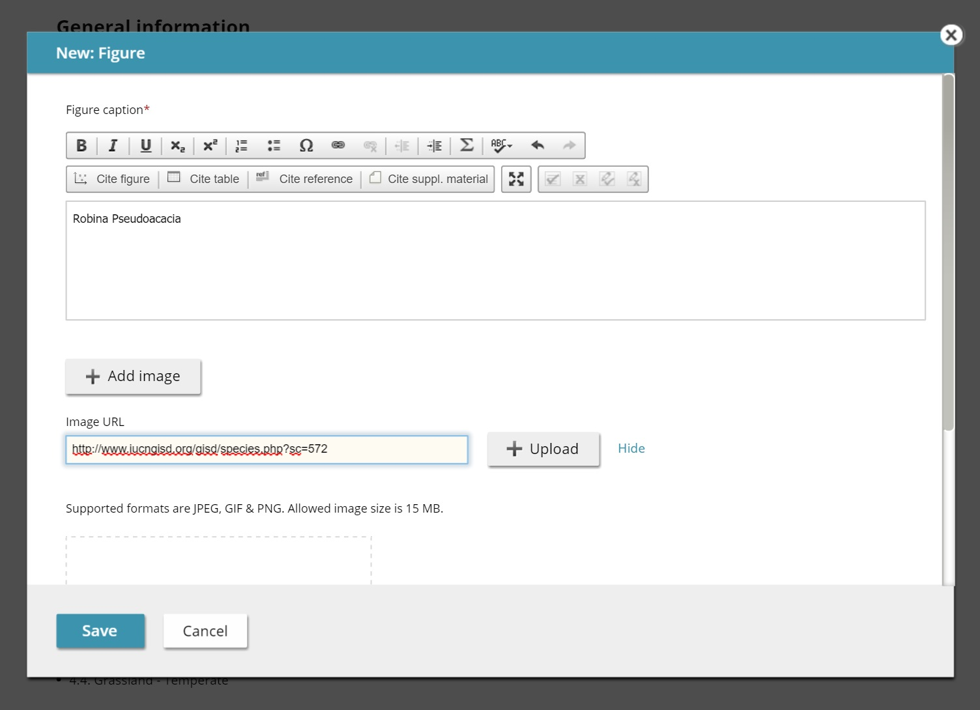
Import a Figure or a Video

Slide 39
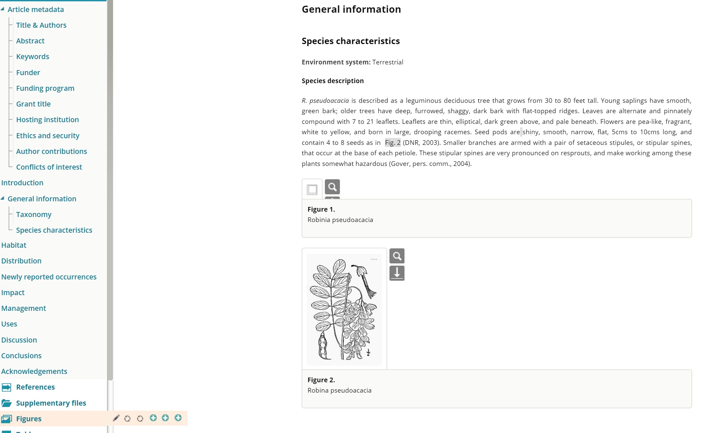
Cited figures (rе-)placed automatically

Slide 40
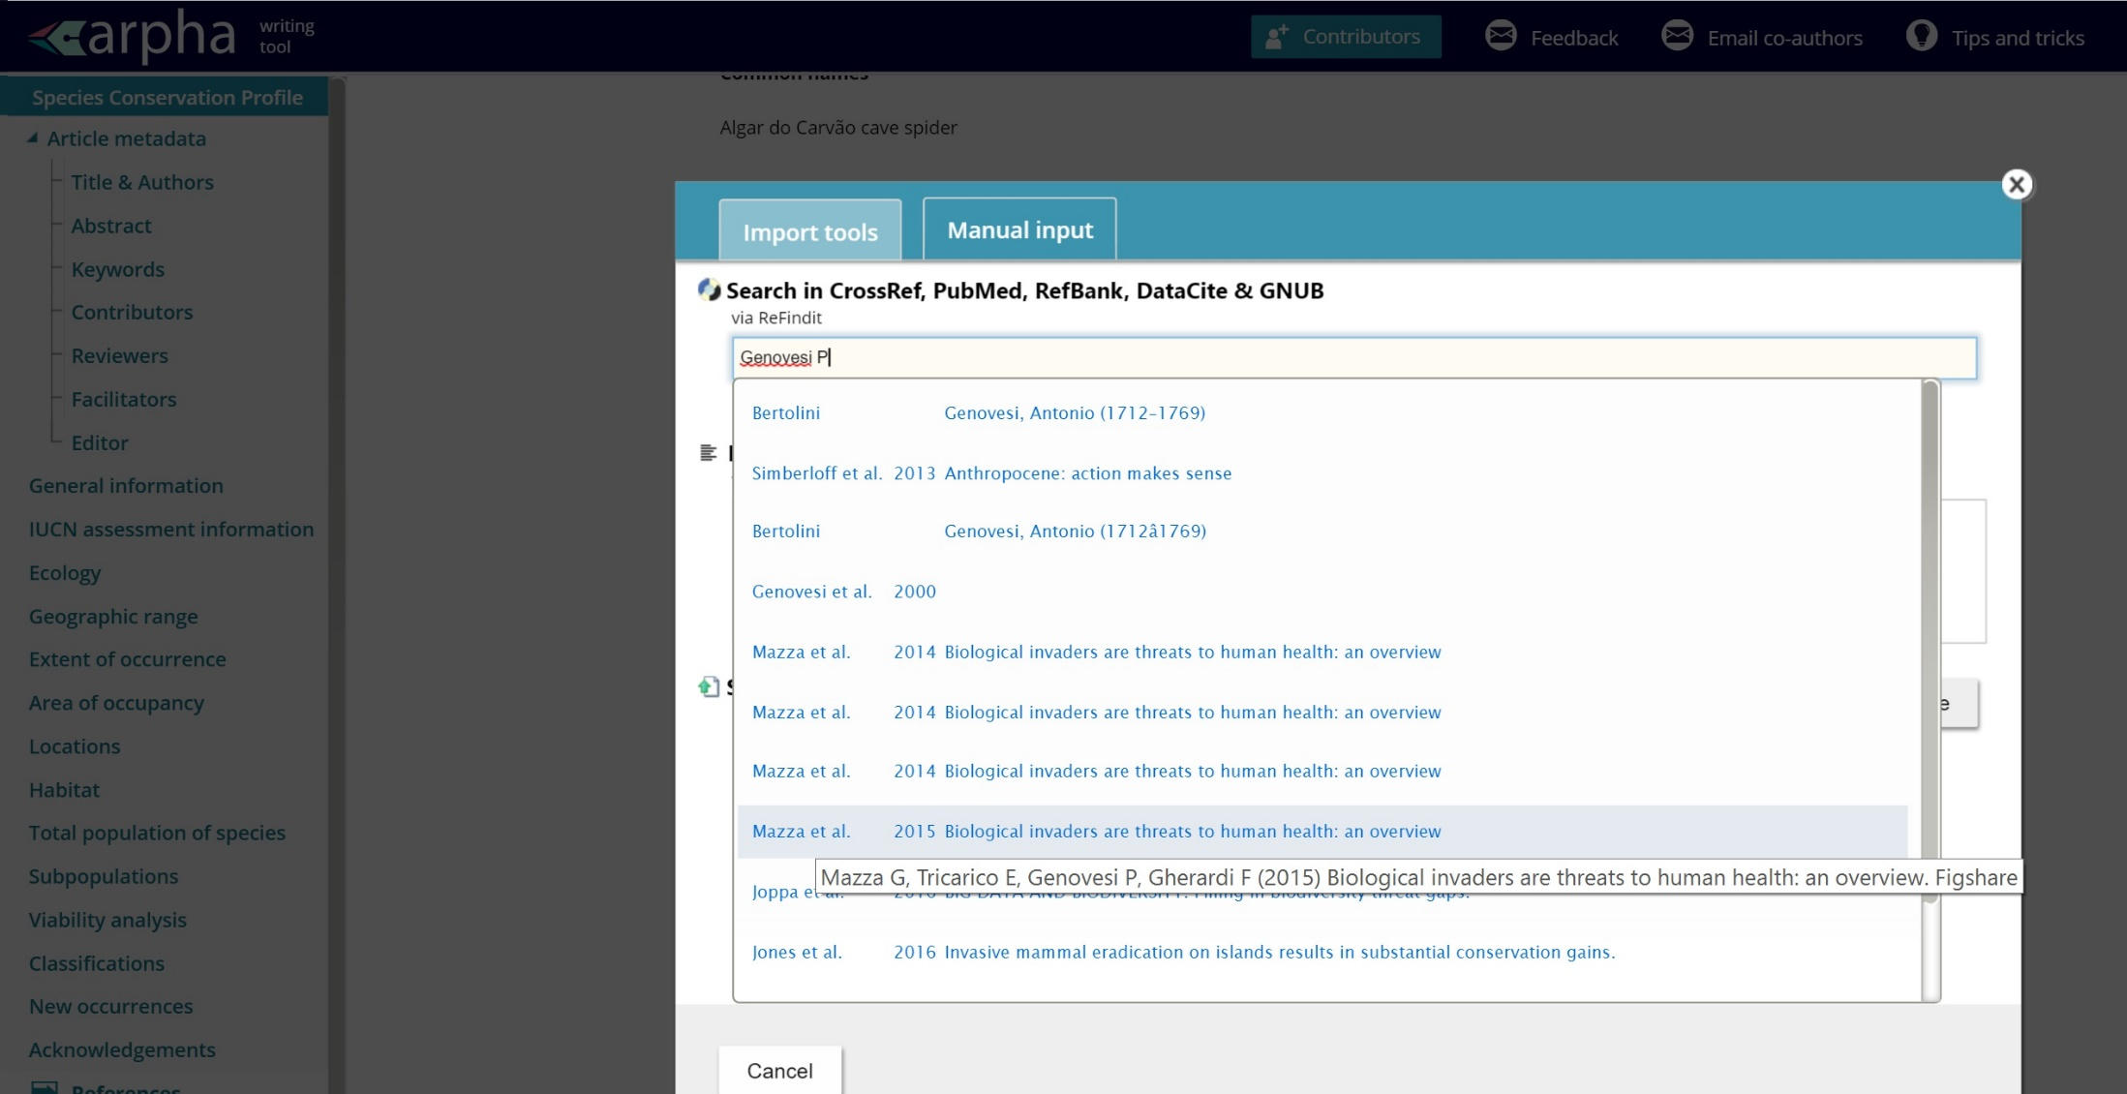
Direct Search & Import of References

Slide 41
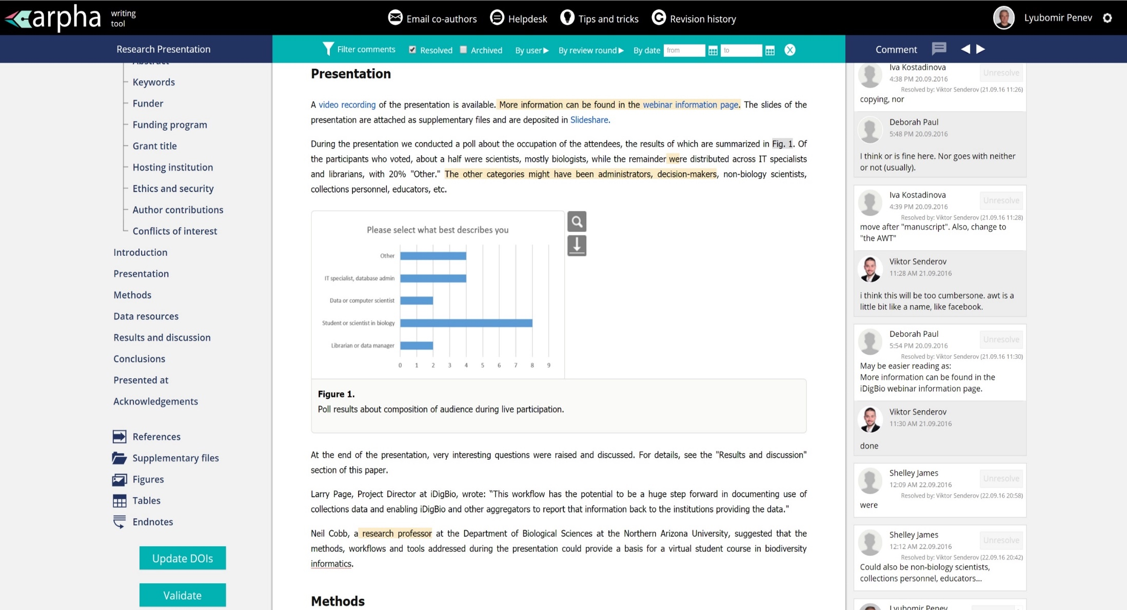
Mandatory Validation Step

Slide 42
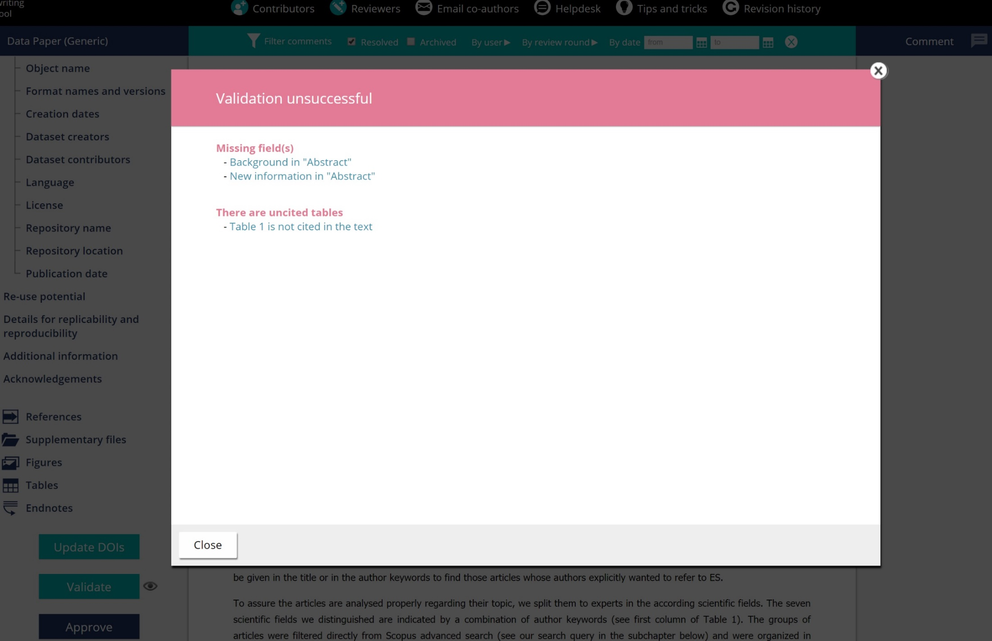
‘Embedded’ Copy-editor

Slide 43
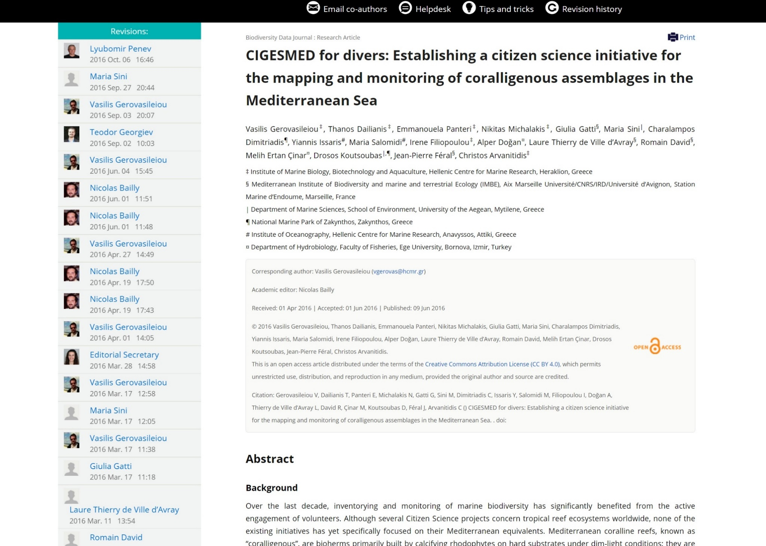
Revision History

Slide 44

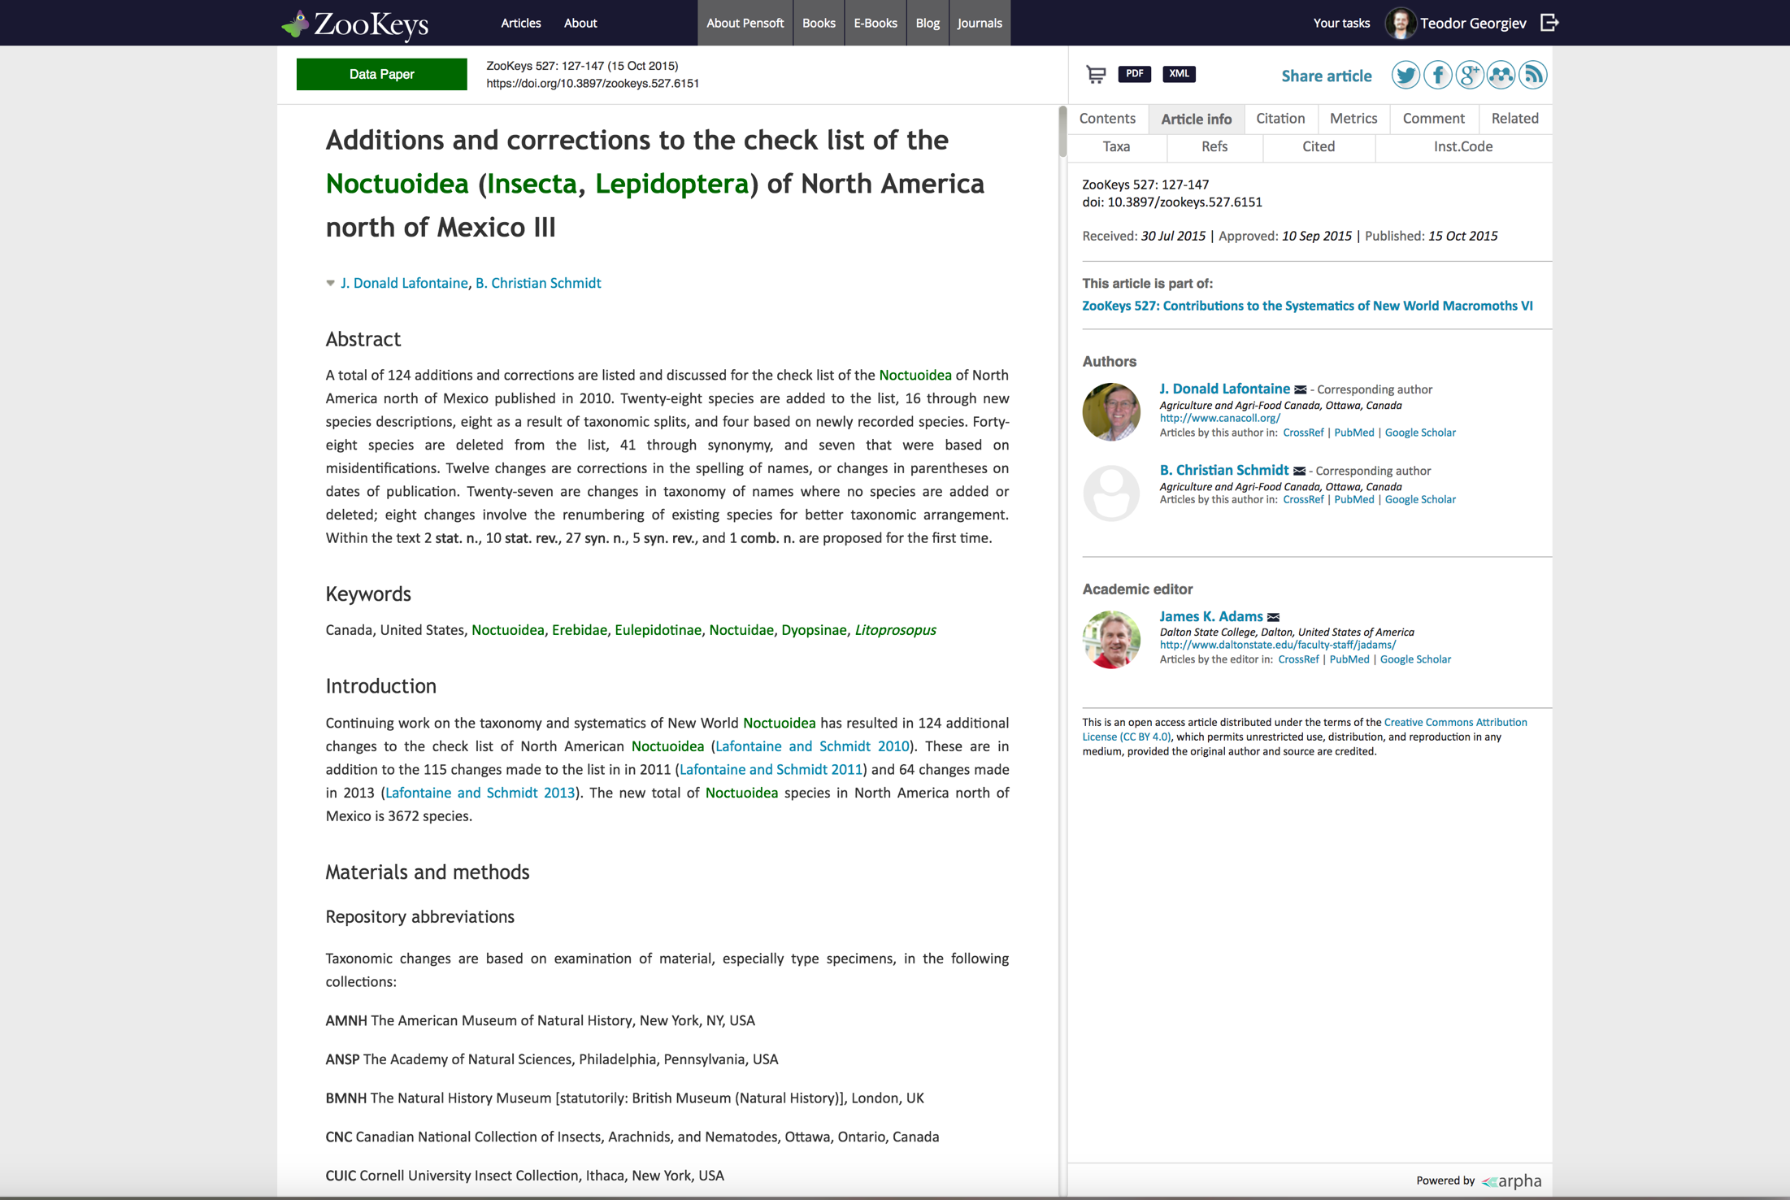
Truly unique: Update your article anytime!
Update your article

Slide 45

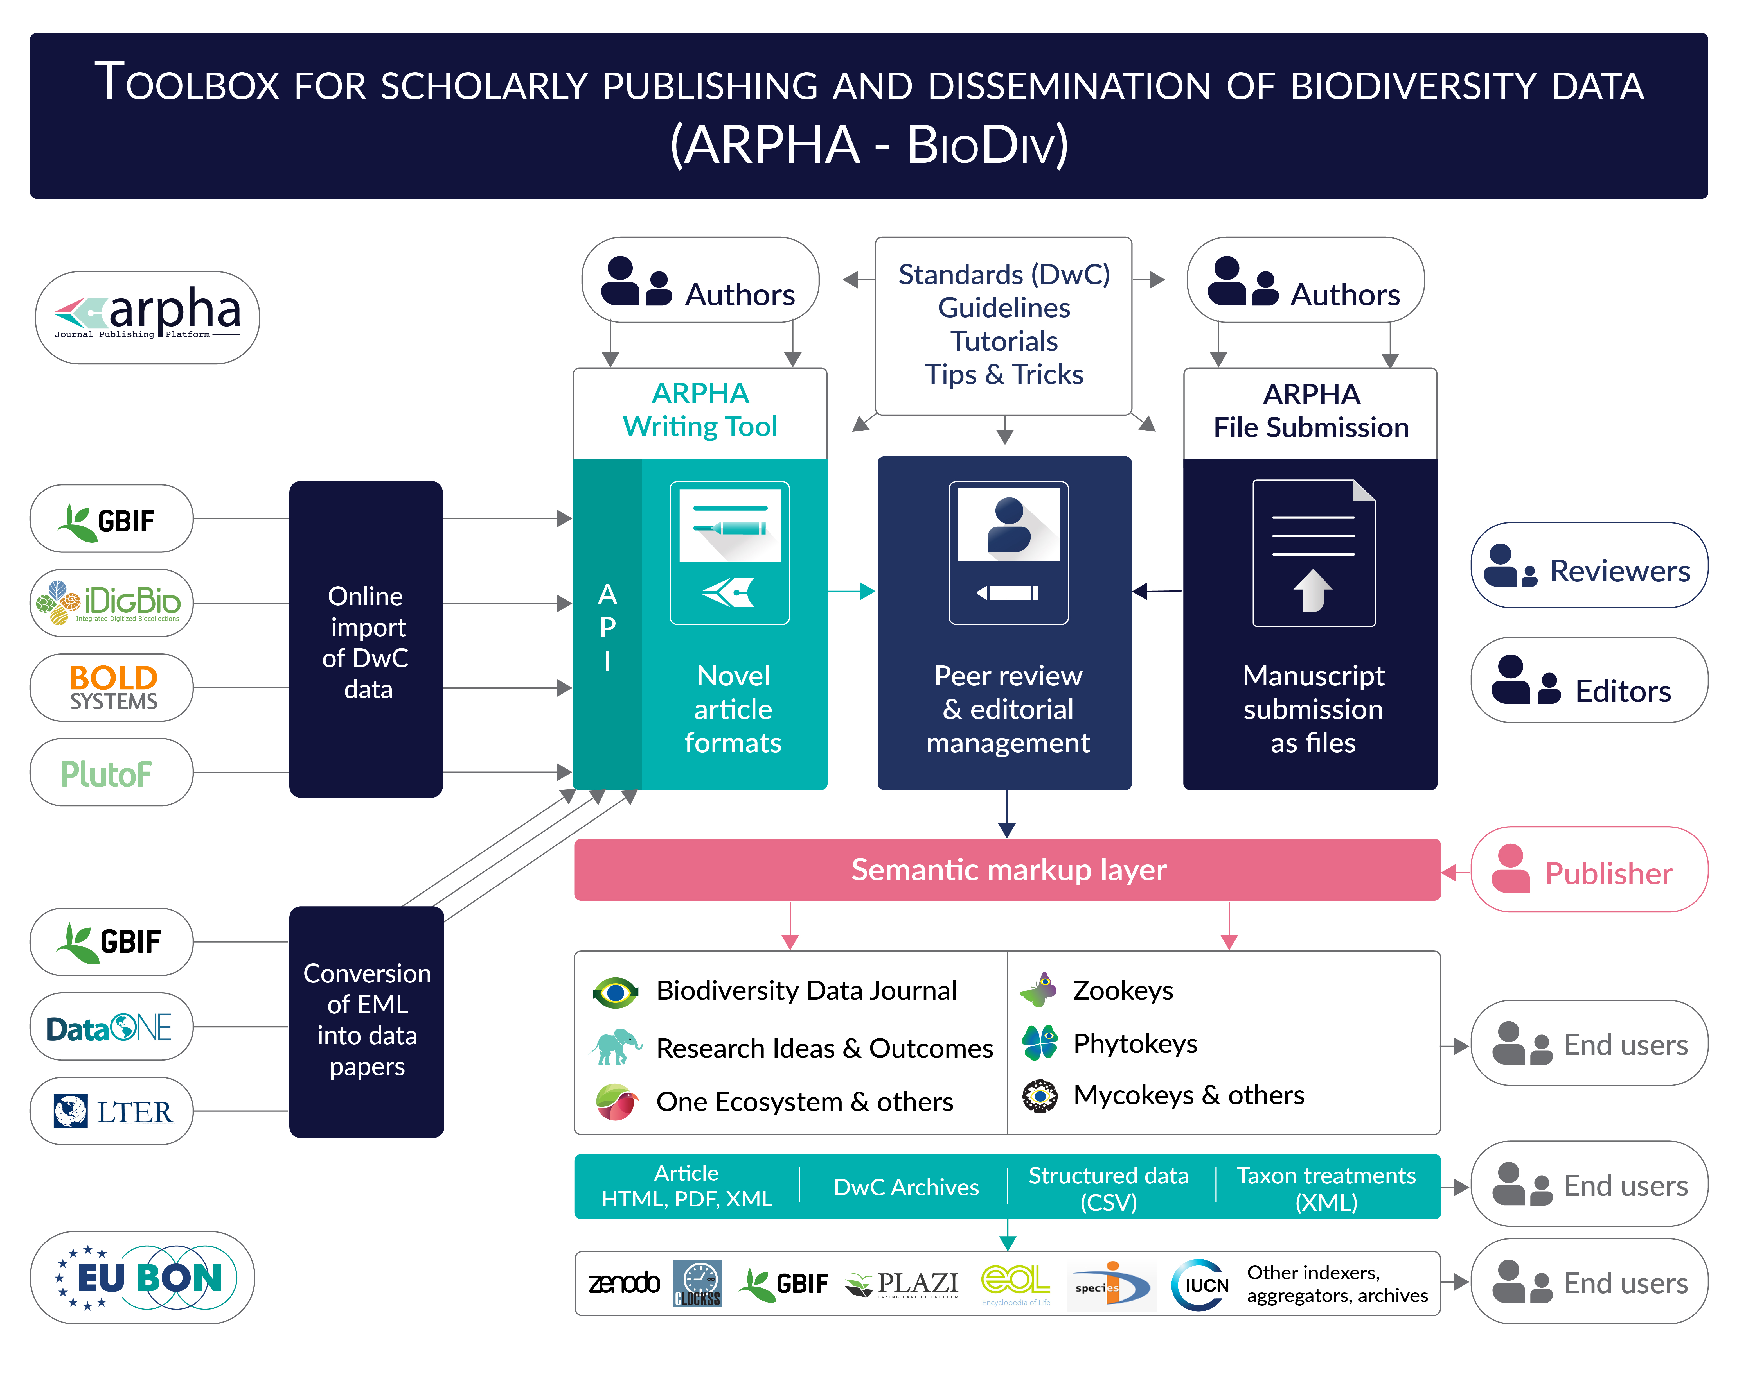
Toolbox for scholarly publishing and dissemination of biodiversity data (ARPHA-BioDiv)

Slide 46

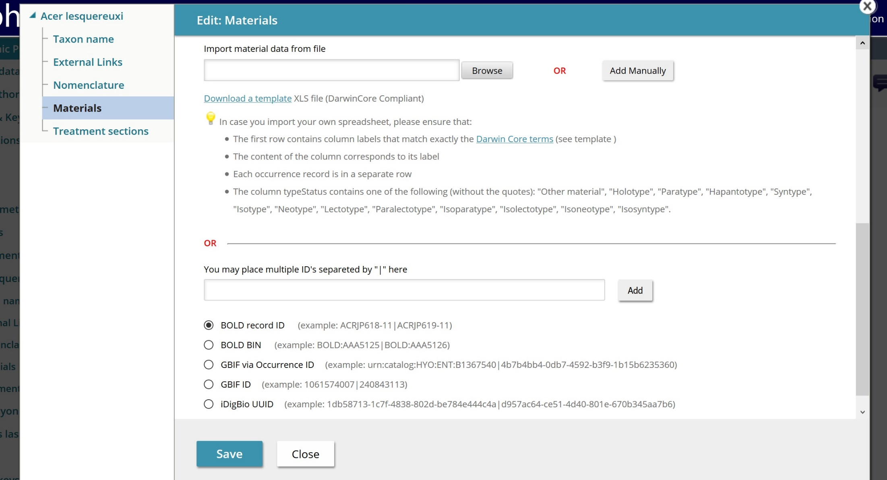
Online Import of Structured Data

Slide 47
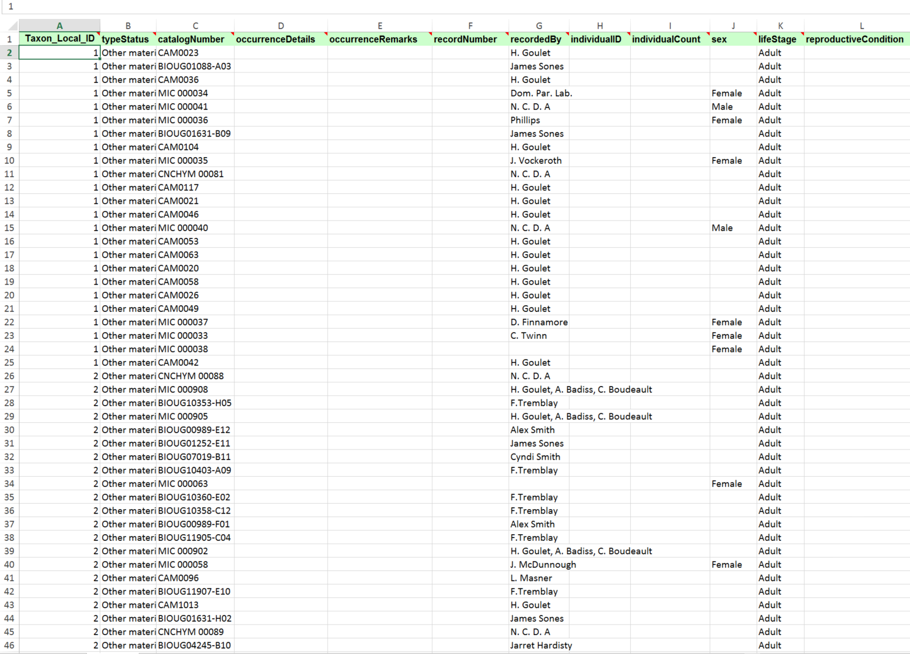
Species Occurrence Data

Slide 48
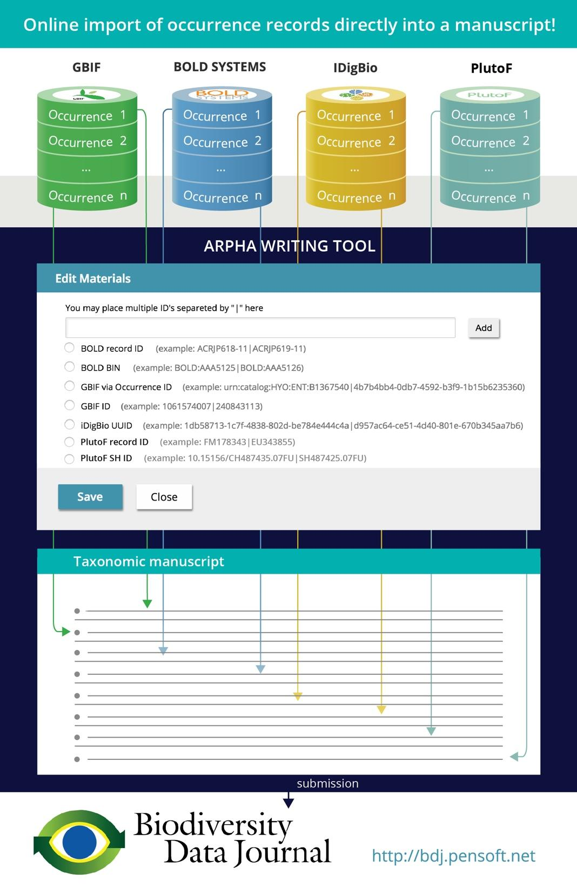





Slide 49
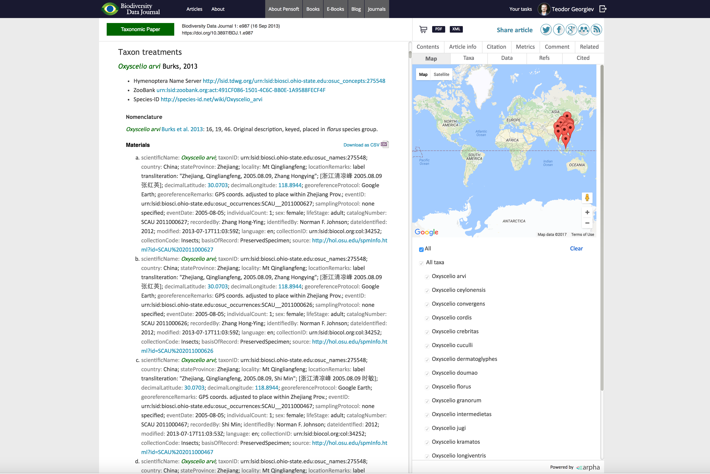
Data Structured within the Text

Slide 50
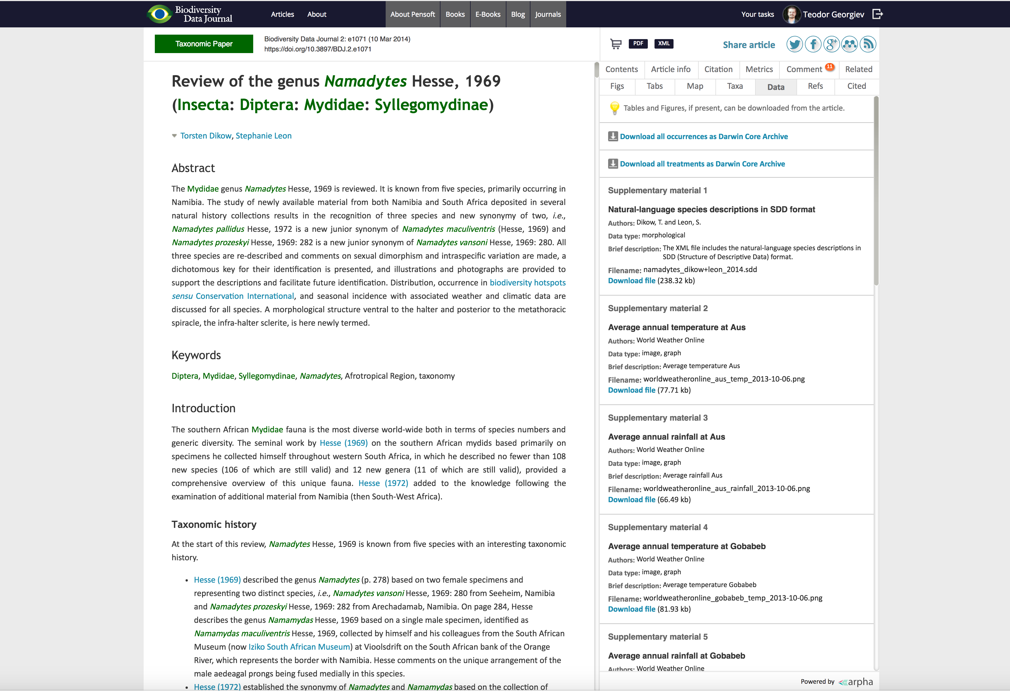
Harvest and Re-use Data

Slide 51
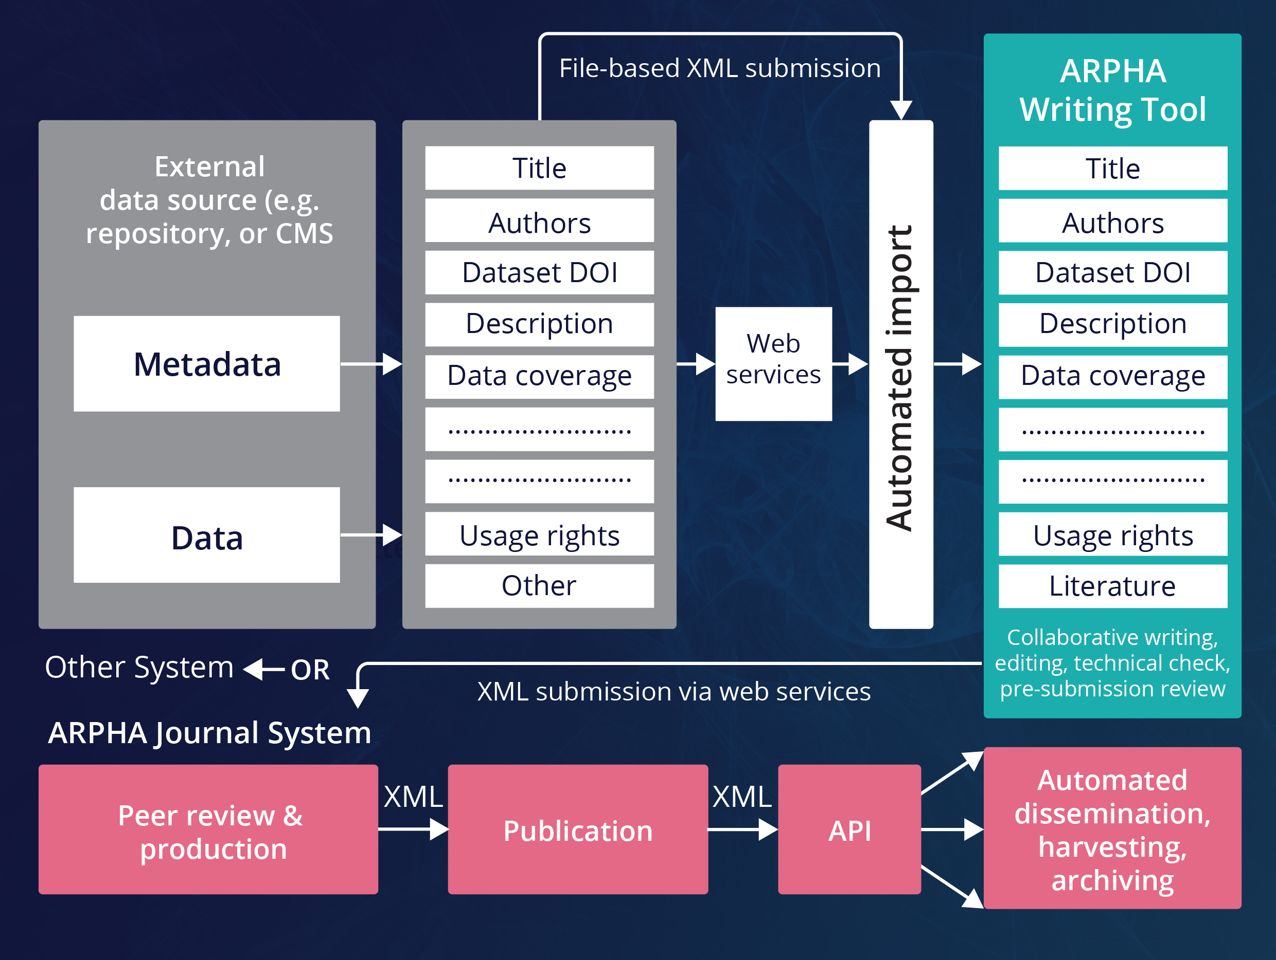
Import an Entire Manuscript through API
Notes:
In first box left “External data source (e.g. repository or CMS)”

Slide 52
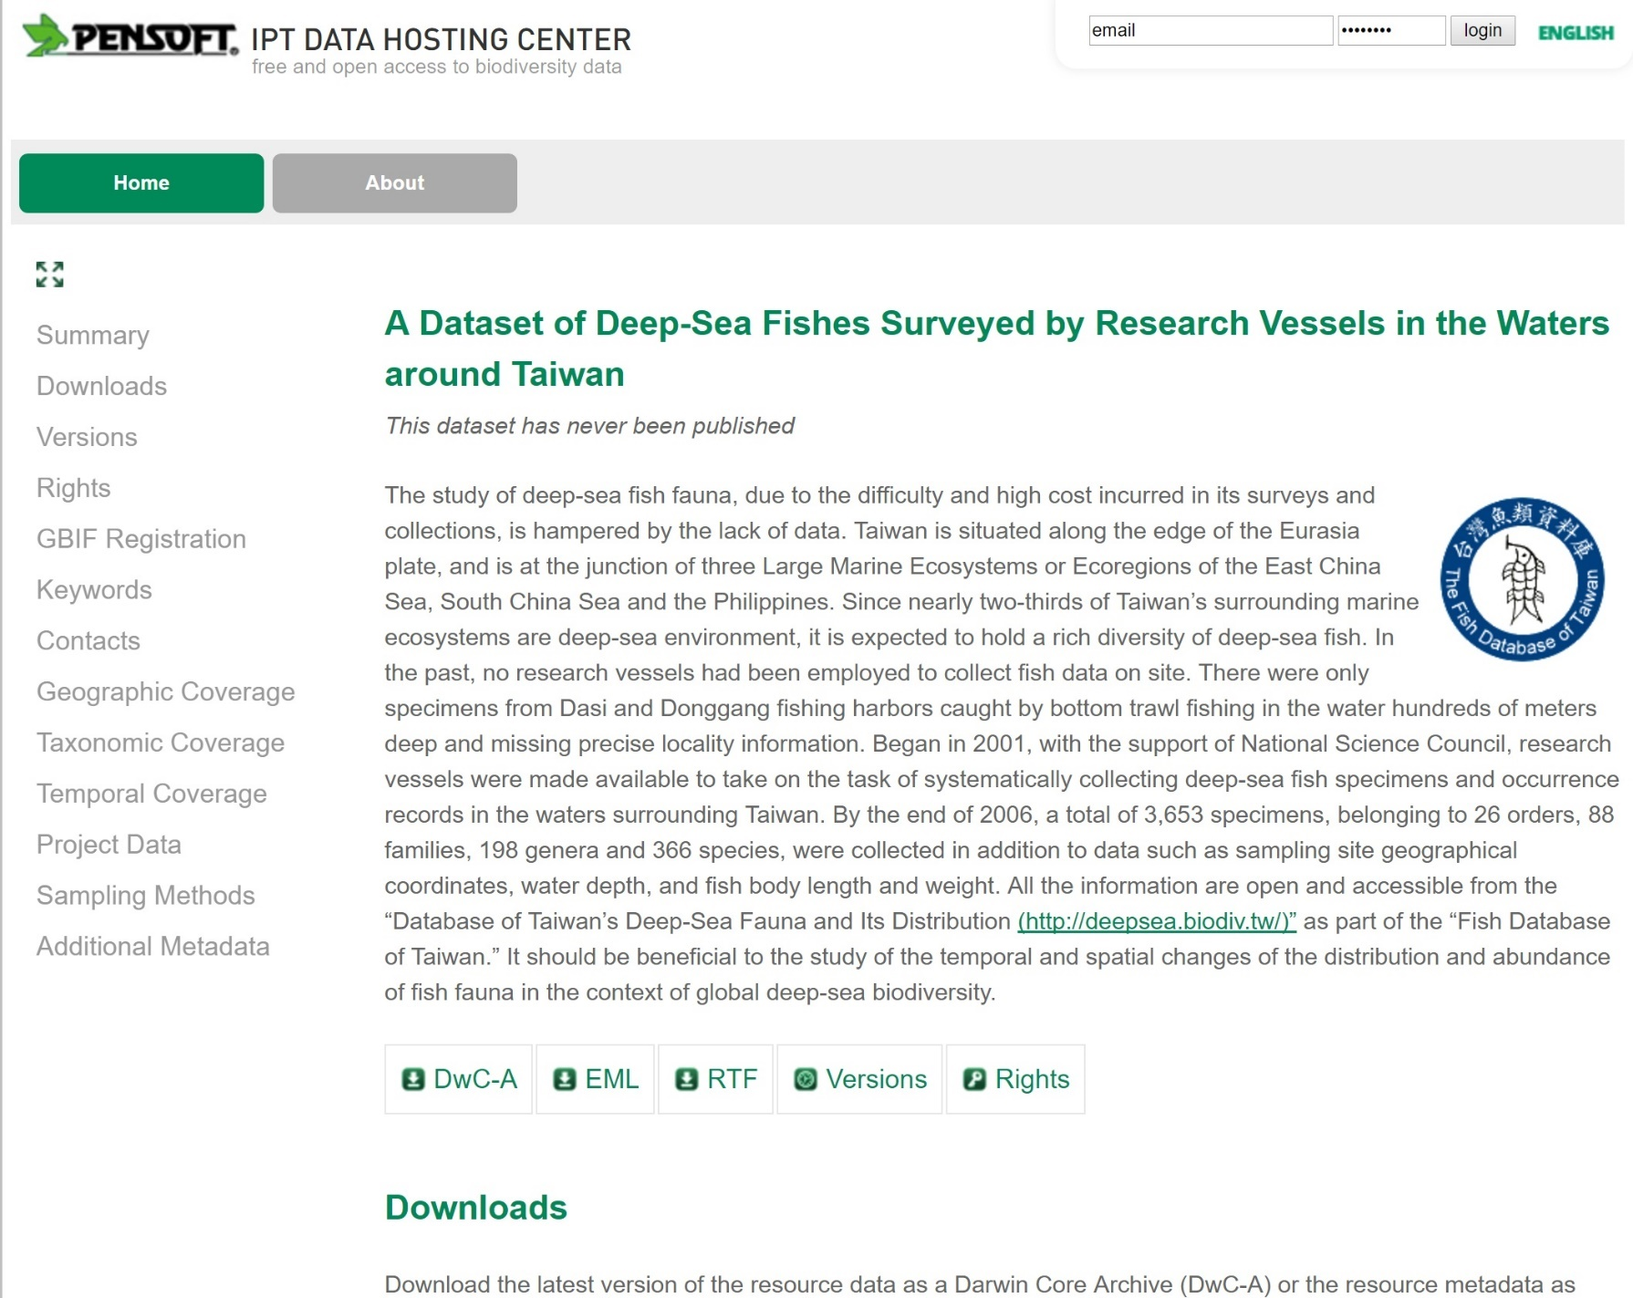
Create a Data Paper from GBIF EML Metadata

Slide 53
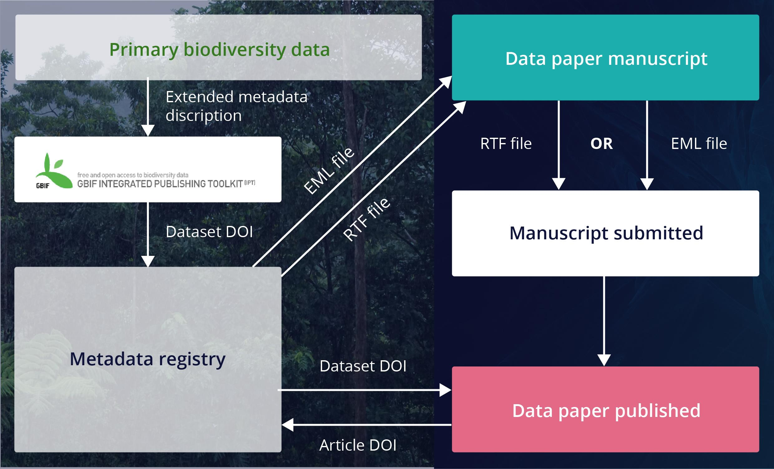
Create a Data Paper from GBIF EML Metadata

Slide 54






Create a Data Paper from EML Metadata

Slide 55

Notes:
Suggest a heading for this slide such as “Example of Data Paper”

Slide 56


Novel Article Formats

Slide 57

Flexible Article Templates

Slide 58

The IUCN Red List Species Page

Slide 59

The IUCN GISD Species Page

Slide 60

IUCN Species Page = Scholarly Publication?
Notes:
The Text box should be adjusted for the text.

Slide 61
Why publish SCPs and ASPs?
A permanent scientific record in a peer-reviewed journal
Citation and credit
Collaborative peer-review and assessment
Expert engagement (e.g. of taxonomists)
Media-rich descriptions of species of conservation importance
Publication in both human - (semantic HTML, PDF) and machine-readable (XML) format
Article- and Sub-Article-Level Metrics
Streamlined continuous update of IUCN Red List via ARPHA
Dissemination via the journals’ networks
Permanent archiving in PubMedCentral, Zenodo, CLOCKSS
Notes:
Best to have all the bullet points within the box.

Slide 62
The Third Day: Let there be Open Science …
Open Access
Open Data
Open Science

Slide 63

What is Open Science?
Open peer review
Open funding
Open science evaluation
Open innovation
Credit: John Parsons, Library Journal 2016, adapted from J.-C. Burgelman’s 2015 presentation.
Notes:
As previously, should this be What is Open Science? (2)

Slide 64

The Open Science Taxonomy
Notes:
Slide 1?

Slide 65
What is Open Science?
Allows for the reproduction of research findings.
Enables transparency in research methodology.
Increases the researcher’s societal impact.
Saves money and time for both researchers and research institutions.
Pontica et al. 2015
Collaborate rather than compete!
Notes:
Maybe “Collaboration rather than competition”
As the following slide has the same title, should this be What is Open Science (1)

Slide 66

EU Open Science Policy Platform (OSPP)
https://ec.europa.eu/research/swafs/pdf/pub_open_science/new_policy_initiative.pdf
Notes:
Slide 1?

Slide 67

Publish the Whole Research Cycle
Teaching
Idea
Support
Read
Develop
Publish
Fund
Process
Plan
Outreach
Teaching
Administration
Credit: CC-BY Cameron Neylon, modified by Daniel Mietchen (Wikimedia.org)

Slide 68
The first
Open Science Journal publishing the
entire research cycle!
Notes:
The text Research Ideas and Outcomes should be re-formatted to be within the text box.

Slide 69

The RIO Journal
https://www.youtube.com/watch?v=2QKp4Ttpemw

Slide 70
Six Unique Features of RIO
RIO publishes all outputs of the research cycle
Published on ARPHA, the first online collaborative platform supporting the full life cycle of a manuscript
Entirely OPEN author-organised pre-submission and community-sourced post-publication peer reviewp
Authors decide how to peer review their manuscripts
Authors can publish article revisions anytime
Emphasises social engagement by mapping research to UN’s Sustainable Development Goals (SDGs)
Notes:
SDGs - is a definition needed?

Slide 71




One Year of Success
1st birthday on 2 Nov 2017
More than 100 articles published so far
Dedicated collections for projects and conferences
Notes:
Congratulations! (Editor’s note only)

Slide 72

Open Peer Review

Slide 73

Giving back to the Community
Publish your project or research group outputs in a special collection
What can you publish?
Abstract
Idea
Presentation
Poster
Video
Infographic
Workshop Report
Hackathon Report
Policy Brief
Research Article
Any other
Notes:
I assume the word was meant to be “Community”?

Slide 74

Project Output Collections
Notes:
Heading for this slide?

Slide 75

EU BON Project Collection
Notes:
Heading for this slide?

Slide 76

Today’s presentation published in RIO
Notes:
Heading for this slide?

Slide 77

We look forward to receiving your inspiring ideas and research outputs!
riojournal.com

Slide 78
But even this is not the end …

Slide 79

Information from Literature
Linked Open Data (LOD)
Notes:
The information extracted in an enhanced publication is still “locked up” in individual XML files
Only individual queries possible with a complicated language XPATH, requiring in-depth knowledge of the structure of the XML
Solution: store the information in a database
Merging information from multiple publications and sources together allowing richer queries and easier reuse.

Slide 80

The Open Biodiversity Knowledge Management System (OBKMS)

Slide 81

What is a Nanopublication?
The smallest unit of publishable information: an assertion about anything that can be uniquely identified and attributed to its author.
Groth, Gibson, and Velterop (2010)
  http://www.nanopub.org

Slide 82

Anatomy of a Nanopublication
Tree RDF named graphs
The assertion: a statement linking two concepts (subject and object) via a third concept (predicate).
The provenance: some metadata to provide context for the assertion.
The publication information: metadata about the actual nanopublication itself.
Credit: nanopub.org
Notes:
Should the sub-title be “Tree of RDF named graphs” or “Three RDF named graphs”?
For presentation purposes, the three boxes for info under nanopublication could be adjusted to make them a similar size.

Slide 83


Acknowledgements
    Our numerous authors, reviewers, editors and partners
    The staff of Pensoft and Plazi
    Slavena Peneva for designing this presentation
    EU BON, BIG4, pro-iBiosphere, ViBRANT
    iDiv Biodiversity Informatics Unit for inviting me for this lecture
Notes:
Should the sub-title be “Tree of RDF named graphs” or “Three RDF named graphs”?
For presentation purposes, the three boxes for info under nanopublication could be adjusted to make them a similar size.

Slide 84




I Open Science!
PLAZI
iDiv Lecture, 15 Feb 2017

